Slide 1

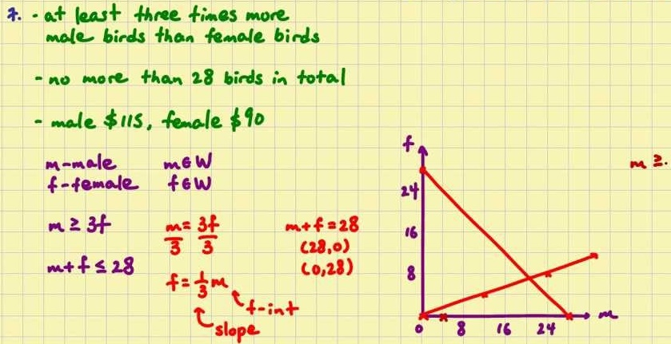
Mathematics (9-1) - iGCSE
2018-20
Year 07
Units 13-16 – Probability, Multiplicative Reading, Constructs and Quadratic Equations

Slide 2
Contents
Page iv
13 Probability 103
13.1 Calculating probability 103
13.2 Two events 104
13.3 Experimental probability 106
13.4 Venn diagrams 107
13.5 Tree diagrams 109
13.6 More tree diagrams 110
13 Problem-solving 112
14 Multiplicative reasoning 113
14.1 Percentages 113
14.2 Growth and decay 114
14.3 Compound measures 115
14.4 Distance, speed and time 117
14.5 Direct and inverse proportion 118
14 Problem-solving 119
15 Constructions, loci and
bearings 120
15.1 3D solids 120
15.2 Plans and elevations 121
15.3 Accurate drawings 1 122
15.4 Scale drawings and maps 123
15.5 Accurate drawings 2 124
15.6 Constructions 125
15.7 Loci and regions 126
15.8 Bearings 128
15 Problem-solving 129
16 Quadratic equations and graphs 131
16.1 Expanding double brackets 131
16.2 Plotting quadratic graphs 132
16.3 Using quadratic graphs 134
16.4 Factorising quadratic expressions 135
16.5 Solving quadratic equations algebraically 136
16 Problem-solving 137

Slide 3
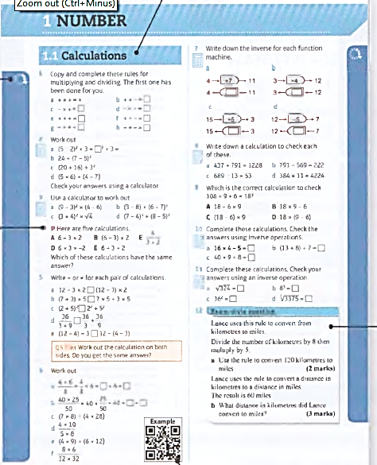
Contents
Page v
Icons alongside the questions show their level of difficulty. Questions in this book will range from 2
to 8
There is a section relating to every mastery lesson in the Student Book
This Practice Book is packed with extra practice on all the content of the Student Book - giving you more opportunities to practise answering simple questions as well as problem-solving and reasoning ones.
The letters P and R are used to show where a question requires you to problem- solve or reason mathematically- essential skills for your GCSE.
Exam-style questions are included throughout to help you prepare for your GCSE exam.
QR codes link to worked examples from the Student Book which will help you with the question they are alongside.

Slide 4
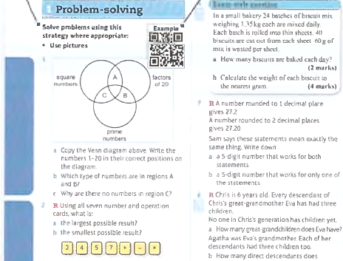
Contents
Page vi
These are strategies that you have learned so far in the Student Book. They build up as you work through the book. Consider whether they could help you to answer some of the following questions.
A QR code is given in the problem solving section where you learn a new strategy in that unit in the Student Book. Scan it to see the worked example and remind yourself of the strategy.
The R symbol indicates questions where you are required to reason mathematically. Questions in this section do not have the P symbol as they are all problem-solving.

Slide 5
13.1 – Calculating Probability
Page 103
R A fair 6-sided dice is rolled,
  Are the events 'an even
  number' and 'an odd
  number' equally likely?
  Which is more likely, a number greater than 3 or a number less than 2? Explain your answers.
Look at this fair 5-sided spinner.
  Write the probability of the spinner landing on blue.
  Write the probability of the spinner landing on either blue or red.
  Write the probability
  of the spinner
  landing on yellow.
  Which colour is half
  as likely as blue?

Slide 6
13.1 – Calculating Probability
Page 103
The letters from the word ATTENDANCE are written on cards and placed in a bag.
Mai picks one card at random from the bag. Work out
  P(D) b. P(A) c. P(E or N)
In a class there are 7 students with blue eyes,
3 students with brown eyes and 3 students with green eyes.
A student is picked at random.
What is the probability that the student
  has blue eyes
  has green eyes
  does not have green eyes?

Slide 7

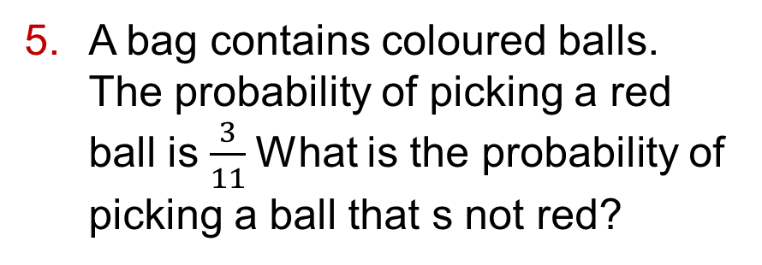
13.1 – Calculating Probability
Page 103
A bag contains coloured balls.
The probability of picking a red ball is $\frac{3}{11}$What is the probability of picking a ball that s not red?
6 – Exam-Style Questions
There are 15 coloured balls in a bag.
3 are red, 5 are blue and 7 are black.
Asha takes a ball from the bag at random.
Write the probability that Asha
takes a red ball (1 mark)
does not take a black ball (1 mark)
takes a white ball. (1 mark)

Slide 8

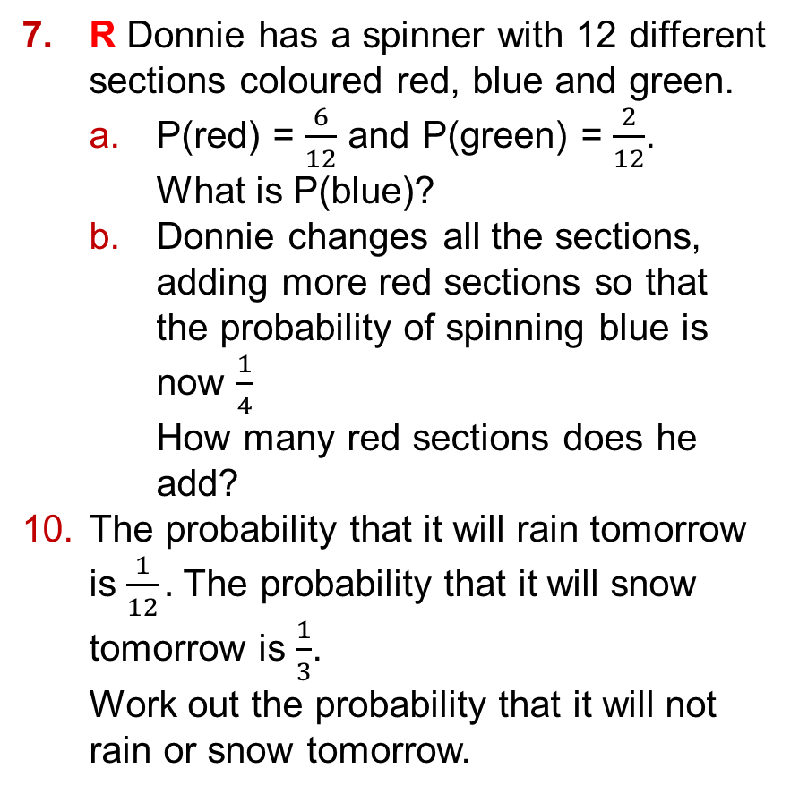
13.1 – Calculating Probability
Page 103
R Donnie has a spinner with 12 different sections coloured red, blue and green.
  P(red) = $\frac{6}{12}$ and P(green) = $\frac{2}{12}$.
  What is P(blue)?
  Donnie changes all the sections, adding more red sections so that the probability of spinning blue is now $\frac{1}{4}$
  How many red sections does he add?
The probability that it will rain tomorrow is $\frac{1}{12}.$ The probability that it will snow tomorrow is $\frac{1}{3}$.
Work out the probability that it will not rain or snow tomorrow.

Slide 9
13.1 – Calculating Probability
Page 103
A fair 6-sided dice is rolled. Are the following pairs of events mutually exclusive?
  Rolling an odd number and rolling a multiple of 2.
  Rolling an odd number and rolling a prime number.
  Rolling an even
  number and
  rolling a multiple
  of 3.
Q8a hint - Can you roll a number that is both odd and a multiple of 2 at the same time?

Slide 10
13.1 – Calculating Probability
Page 103
A fair 12-sided dice numbered 1 to 12 is rolled.
Are these pairs of
events exhaustive?
  Rolling an odd number and rolling an even number
  Rolling a prime number and rolling a factor of 12
  Rolling a multiple of 2 and rolling a number less than 11
  Workout
    P(prime number)
    P(factorof6)
    P(number less than 12).

Slide 11
13.1 – Calculating Probability
Page 104
A 4-sided dice has the numbers 1 to 4 on its faces. The table shows the probabilities of rolling 1, 2 and 4.
  Work out P(3).
  Write P(prime number) as
    a fraction
    a percentage.
  Harrison rolls the dice 200 times.
  Predict the number of times he will roll 2.
Outcome | 1 | 2 | 3 | 4
Probability | 0.5 | 0.1 |  | 0.2

Slide 12
13.1 – Calculating Probability
Page 104
P A 2-character password is made up of a vowel followed by a single digit,
  How many possible combinations are there?
  What is the probability of someone getting the password right first time by chance?
  It is known that the password does not contain an 0 or a U. What is the probability of someone getting the password right first time by chance?

Slide 13
13.2 – Two Events
Page 104
This spinner is spun twice.
  Copy and complete the sample space diagram to show the possible outcomes.
  How many possible
  outcomes are there?
  Write the probability
  of getting red twice,
  Write the probability
  of getting one red
  and one blue.
  Write the probability
  of getting at least one blue.
 |  | 2nd Spin
 |  | Red | Blue
1st Spin | Red | R, R
 | Blue

Slide 14
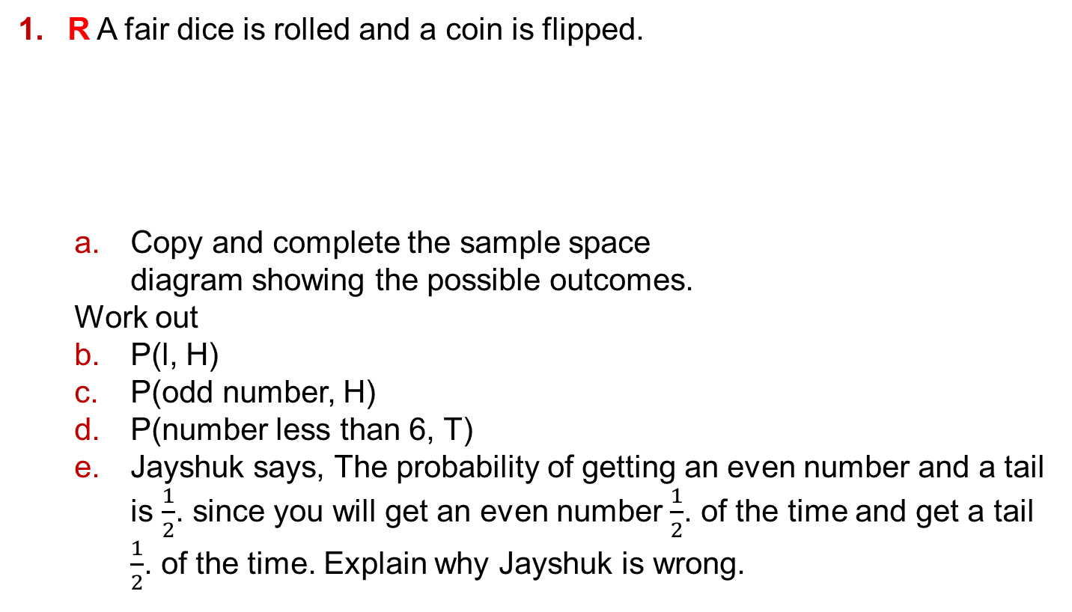
13.2 – Two Events
Page 104
R A fair dice is rolled and a coin is flipped.
  Copy and complete the sample space
  diagram showing the possible outcomes.
  Work out
  P(l, H)
  P(odd number, H)
  P(number less than 6, T)
  Jayshuk says, The probability of getting an even number and a tail is $\frac{1}{2}$. since you will get an even number $\frac{1}{2}$. of the time and get a tail $\frac{1}{2}$. of the time. Explain why Jayshuk is wrong.
 | Head | Tail
1 | 1, H | 1, T
2 | 2, H
3
4
5
6
Q2a hint - Show any working then write 'Jayshuk is wrong because …..

Slide 15
13.2 – Two Events
Page 104
These two spinners are spun.
  Draw a sample space diagram to show all 1 the possible outcomes,
  Find the probability that both spinners land on the same colour,
  Predict the number of times both spinners will land on blue in 60 spins.

Slide 16
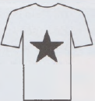
13.2 – Two Events
Page 105
4 – Exam-Style Questions
A company makes T-shirts
in five different colours:
yellow, red, blue, green and
white.
They let you choose
between two different logos: a star or a tree. One possible T-shirt is shown,
List all the possible T-shirts you could order. The first one is done for you. (white, star) (2 marks)
A T-shirt is picked at random.
Work out the probability that the T-shirt is blue with a tree on the front. (1 mark)

Slide 17
13.2 – Two Events
Page 105
A necklace is
made using two
beads.
There is a choice
of gold, silver and emerald beads,
  Draw a sample space diagram showing all the options.
  How many possible combinations are there?
  A necklace is picked at random. Write the probability that it has
    only gold beads
    a silver bead and an emerald bead
    at least one emerald bead.

Slide 18
13.2 – Two Events
Page 105
Two fair dice numbered 1-6 are rolled and the product of the scores is found.
  Copy and complete the sample space diagram showing the possible total scores.
  Find the probability of scoring
  i a total of 6 ii more than 20
  iii an even number iv a multiple of 3.
  Which is more likely, scoring a multiple of 3 or a multiple of 5?
Dice 1 | 1
 | 2 | 2 | 4
 | 3 |  |  | 9 | 12
 | 4
 | 5 |  |  | 20
 | 6
 |  | 1 | 2 | 3 | 4 | 5 | 6

Slide 19
13.2 – Two Events
Page 105
P Sam puts three £1 coins and a 50p coin in one pocket. He puts a £1 coin and two 10p coins in another pocket.
He takes a coin from each pocket at random. What is the probability of him getting more than £1?
These two spinners are spun and the scores are added.
Work out the probability that the total score is more than 4.

Slide 20
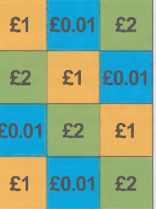
13.2 – Two Events
Page 105
P In a game, a player rolls a coin onto a board.
The board has the values of £0.01, £1 and £2 on it.
The probability of landing on each square is equally likely.
If the coin lands heads up on a square, the player wins the value shown in the square.
The game costs £1
to play. Kali thinks
that a player is more
likely to lose money
than win.
Is she correct?

Slide 21

13.3 – Experimental Probability
Page 106
Amery spun this
spinner 20 times.
  Copy and complete the frequency table to record his outcomes.
  4, 6, 2, 2, 6, 4, 6, 6, 8, 2, 10, 2, 6, 6, 4, 2, 6, 8, 8, 6
  What does the frequency tell you? Write a definition in your own words.
Outcome | 2 | 4 | 6 | 8 | 10
Probability

Slide 22
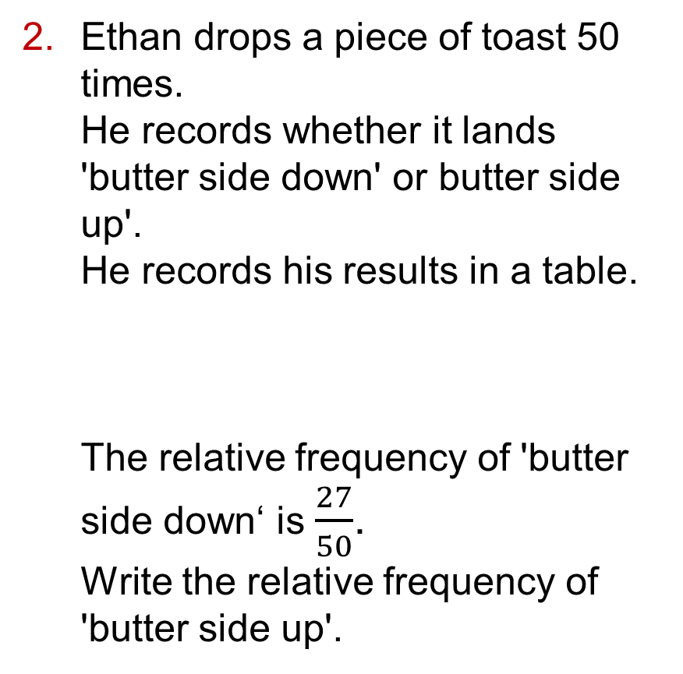
13.3 – Experimental Probability
Page 106
Ethan drops a piece of toast 50 times.
He records whether it lands 'butter side down' or butter side up'.
He records his results in a table.
The relative frequency of 'butter side down‘ is $\frac{27}{50}$.
Write the relative frequency of 'butter side up'.
 | Up | Down
Probability

Slide 23
13.3 – Experimental Probability
Page 106
Sansa rolls a 6-sided dice.
She records her results in a table.
  How many trials did Sansa do?
  What is the relative frequency of her scoring 6?
Vinny thinks a coin is biased. He flips it 20 times and it lands heads up 13 times.
He thinks this shows that the coin is biased. Do you agree? How could he get a more accurate measure of probability?
 | 1 | 2 | 3 | 4 | 5 | 6
Frequency | 17 | 19 | 11 | 16 | 15 | 22

Slide 24
13.3 – Experimental Probability
Page 106
Inu and James are recording the colours of cars that pass by.
Their results are recorded in the table.
  How many cars did Inu record?
  Write the estimated probability of a black car from Inu's results,
  How many cars did James record?
  Write the estimated probability of a black car from James's results,
  Altogether Inu and James recorded 240 cars.
  What is the estimated probability of a black car from their combined results?
  Which is the best estimate for P(black)? Explain.
 | Red | Blue | Black | White | Grey | Green
Inu | 12 | 14 | 20 | 21 | 32 | 1
James | 15 | 29 | 23 | 29 | 41 | 3

Slide 25
13.3 – Experimental Probability
Page 106
Martin spins this
spinner and records
the number spun
each time.
  What is the experimental probability of Martin scoring a 1?
  What is the theoretical probability of Martin scoring a 1 if the spinner is fair?
 | 1 | 2 | 3
Frequency | 13 | 9 | 8

Slide 26
13.3 – Experimental Probability
Page 106
A game is played where a coin is flipped and an ordinary 6-sided dice is rolled.
A player wins if they get a head and an even number.
The table shows the
results of 40 games.
  What is the experimental probability of winning?
  What is the theoretical probability of winning?
  How many wins would you predict in 40 turns?
  Do you think either the dice or the coin is biased? Explain your answer.
 | Win | Lose
Frequency | 13 | 9

Slide 27
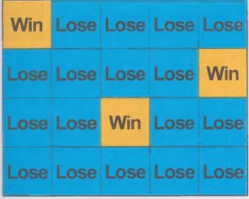
13.3 – Experimental Probability
Page 107
P At a town fayre a game is
played where a coin is flicked
onto a board.
Maria claims the probability
of winning on any go is She
charges 50p per go and gives
£1 for each winning throw.
  Maria expects 100 people
  to play.
  If her claim is true, how much
  money will she make?
  The table shows the
  actual results.
  Estimate the probability of winning from this information.
 | Win | Lose
Frequency | 17 | 83

Slide 28
13.3 – Experimental Probability
Page 106
9 – Exam-Style Questions
Win | Lose
1 | 22
2 | 9
3 | 9
4 | 10
Sarah spins a biased
spinner numbered 1-4
50 times.
The table shows her
results.
She spins the spinner
once more.
Find an estimate for the probability that she will get a 4. (1 mark)
Mark has a biased spinner numbered 1-2. The probability that he will spin a 1 is 0.4. Mark is going to spin the spinner 200 times.
Work out an estimate for the number of times he will spin a 1. (2 marks)
Exam hint
Show your working. If you calculate your answer incorrectly, you may still get marks for method.

Slide 29
13.3 – Experimental Probability
Page 107
The table shows some information about parcels posted at a particular post office.
  Work out the probability that a parcel picked at random is being posted
    first class
    second class going overseas.
  A second class parcel is picked at random. What is the probability that it is being posted overseas?
 | UK | Overseas | Total
First Class | 75 | 18 | 93
Second Class | 91 | 4 | 94
Total | 166 | 22 | 188

Slide 30
13.3 – Experimental Probability
Page 107
Lisa records the type and colour of vehicles passing her house on Saturday afternoon. The table shows her results.
  Estimate the probability that the next car to go past Lisa's house is
    a white van ii a red bus.
  Which is more likely to pass her house, a red car or a white bus?
  Which type of vehicle is most likely to be white?
  Which type of vehicle is most likely to be red?
  What is the most likely car colour?
 | Red | Black | White | Other
Bus
Van
Car

Slide 31
13.4 – Venn Diagrams
Page 107
Set A = {even numbers less than 10}
Set B = {prime numbers less than 10}
  List the numbers in each set:
  A = {2, 4, ...}, B = {2, 3,...}
  Write 'true' or 'false' for each statement.
  i 8 є A ii 9 є B iii 12 є B
  Which number is in both sets?
  Which numbers are in set A only?
  Which numbers are in either A or B (or both)?
  Which numbers less than 10 are not in A or B?

Slide 32

13.4 – Venn Diagrams
Page 108
The Venn
diagram shows 2
sets, A and B,
and &, the set of
all numbers being
considered.
  Copy and complete these sets. A = (5,□, □)
  B = (2, 4, □, □, □, □, □, □)
  & = (1, 2, 3, ...)
  Match each set to its description.
Q2a hint - & includes all the numbers in A and B too.

Slide 33
13.4 – Venn Diagrams
Page 108
Copy and complete the Venn diagram for these sets.
  & = {integers from 1 to 20}
  X = {even numbers from 1 to 20}
  Y = {odd numbers from 1 to 20}

Slide 34
13.4 – Venn Diagrams
Page 108
For the Venn diagram in Q2, copy and complete these sets.
  A ∩ B = {□}
  A ∪ B = {2, 4,...}
  A' = {1,...}
  B' = {1,...}
  A' ∩ B = {...}
For the Venn diagram you drew in Q3, write these sets.
  X ∩ Y
  X ∪ Y
  X'
  Y’
  X' ∩ Y
  X ∪ Y'

Slide 35

13.4 – Venn Diagrams
Page 108
The owner of a bed shop records the number of customers
and the numbers of mattresses
and beds sold in one week.
The Venn diagram shows the
results.
  How many beds were sold?
  How many customers bought
  a bed, a mattress or both?
  What is the probability that a
  customer picked at random
  bought a bed and a mattress?
  What is the probability that a customer picked at
  random bought only a mattress?
  A shop assistant says, 'The Venn diagram shows
  that five mattresses were sold.'
  Explain why he is wrong.

Slide 36
13.4 – Venn Diagrams
Page 108
The manager of a coffee shop records customers' purchases before 11 am.
Of the 100 customers surveyed, 37 buy only a drink and 23 buy a drink and a snack.
All customers buy something,
  Draw a Venn diagram to show the manager's findings.
  What is the probability that a customer picked at random buys only a drink?
  What is the probability that a customer picked at random buys a snack?

Slide 37
13.4 – Venn Diagrams
Page 108
8 – Exam-Style Questions
B is the set of students studying biology.
C is the set of students studying chemistry. The Venn diagram shows the number of students in each set.
Work out P(B ∩ C). (2 marks)
Work out P(B' U C'). (2 marks)

Slide 38
13.5 – Tree Diagrams
Page 109
In a pack of yogurts, 2 are strawberry and 4 are raspberry.
  What is the probability of picking a raspberry yogurt?
  Angelica picks a yogurt at random.
  It is raspberry and she eats it.
  How many yogurts are left in the pack?
  How many raspberry yogurts are left in the pack?
  She picks another yogurt at random,
  What is the probability of picking a raspberry yogurt this time?

Slide 39
13.5 – Tree Diagrams
Page 109
Which of these pairs of events are independent?
  Taking a chocolate from a box, eating it, and then taking another chocolate from the box.
  Getting a head on the first flip of a coin and then getting a tail on the second flip.
  Rolling a prime number on a dice and then rolling an odd number.
  Rolling a 6 on a dice and then rolling another 6.

Slide 40
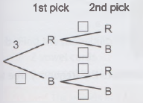

13.5 – Tree Diagrams
Page 109
Livia has a bag containing 3 red marbles
and 4 blue marbles.
She picks a marble at random, records
the colour, puts the marble back in the bag
and then picks another marble at random.
The frequency tree shows the possible
outcomes.
  Copy the frequency tree.
  3 is on the first branch as there are 3 red marbles.
  How many blue marbles are there?
  Use your answer to complete the branches for the 1st pick on the frequency tree,
  Livia puts the marble back in the bag.
  How many red and blue marbles are in the bag when she picks another one?
  Complete the branches for the 2nd pick by filling in the rest
  of the numbers.

Slide 41
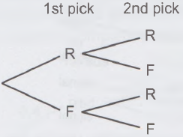

13.5 – Tree Diagrams
Page 109
A bag contains 10 apples.
4 are rotten and 6 are fresh.
Henry picks an apple from the bag, replaces it and then takes a second apple,
  Copy and
  complete this
  frequency tree.
  How many ways are there of picking two fresh apples?
Q4 hint –

Slide 42
13.5 – Tree Diagrams
Page 109
A box of sweets contains 10 toffees and 5 chocolates.
Yvonne picks a sweet at random, puts it back and picks another sweet.
Draw a frequency tree to show this.

Slide 43

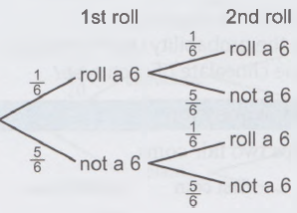

13.5 – Tree Diagrams
Page 109
The tree diagram shows the probabilities that Aman will roll a 6 during two rolls of a dice.
  What is the probability he rolls a 6 on the first roll?
  What is the probability that he rolls two 6s?
  What is the probability that he doesn’t roll a 6 in either roll?
  What is the probability that he rolls only one 6? Explain your answer.

Slide 44
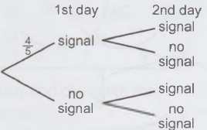
13.5 – Tree Diagrams
Page 110
Abbot's phone signal is unreliable. The probability he has a signal on any day is f.
  Write the probability that he doesn't have a signal.
  Copy and compete the tree diagram.
  Work out the probability that he has a signal for two days in a row.
  Work out the probability that he has no signal on the first day but a signal on the second day.

Slide 45
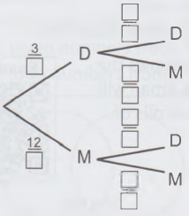
13.5 – Tree Diagrams
Page 110
A box of chocolates contains 3 dark chocolates and 12 milk chocolates.
Mr. Murphy picks a chocolate at random, notes the type and puts it back the box. He then picks another chocolate.
  Copy and complete the tree diagram.
  What is the
  probability that
  Mr. Murphy picks
  one chocolate
  of each type?

Slide 46
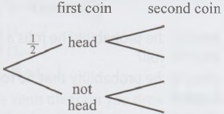
13.5 – Tree Diagrams
Page 110
9 – Exam-Style Questions
Sophie is making Christmas cards. She needs a card and an envelope for each card.
Copy and complete the probability tree diagram to show the outcomes.
Label clearly the branches of the probability tree diagram. (2 marks)
Calculate the probability that Ganit gets a head on both coins. (1 mark)
Calculate the probability that Ganit gets at least one head. (2 marks)

Slide 47
13.6 – More Tree Diagrams
Page 110
Are these pairs of events dependent or independent?
  Rolling a 3 on a dice and getting a tail when flipping a coin
  Picking a dark chocolate at random from a bag of sweets, eating it, then picking another dark chocolate
  Flipping a coin and getting a head, then flipping the coin again and getting another head
  Spending too much and getting into debt

Slide 48
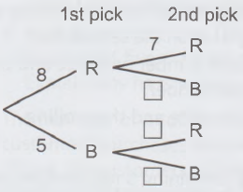
13.6 – More Tree Diagrams
Page 110
Charlie's sock drawer contains 8 red socks and 5 blue socks.
The frequency tree shows what happens when he picks a sock at random, puts it on and then picks another sock.
Copy and complete his frequency tree.

Slide 49
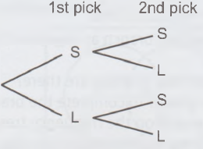
13.6 – More Tree Diagrams
Page 110
A bag of sweets
contains 12 strawberry
sherbets and 8 lemon
sherbets.
Julie picks a sweet,
eats it, and then picks another one.
  Copy and complete the frequency tree to show this.
  How many ways are there of picking two lemon sherbets?

Slide 50
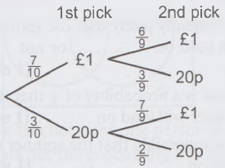

13.6 – More Tree Diagrams
Page 111
Amy has a bag of coins containing seven £1 coins and three 20p coins.
She picks a coin at random, puts it in her pocket and then picks another coin.
Use the tree diagram to find
the probability that she picks
  two £1 coins
  one of each type of coin.

Slide 51
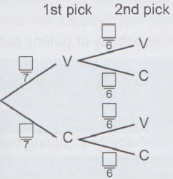

13.6 – More Tree Diagrams
Page 111
Qamar has these letter cards.
He picks two cards at random without replacing them.
He records whether the letter on the card is a vowel or a consonant,
  Copy and complete the tree diagram.
  Find the probability that he picks
    2 vowel cards
    1 consonant card and 1 vowel card.
Q5 hint - The vowels are A, E, I, 0 and U.

Slide 52
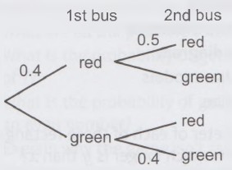
13.6 – More Tree Diagrams
Page 111
R Danny takes two buses to get to school. The probability that the first bus is red is 0.4. If the first bus is red, the probability that the second bus is red is 0.5.
If the first bus is green, the probability that the second bus is green is 0.4.
  Copy and complete the
  tree diagram.
  What is the probability
  that both buses are red?
  What is the probability
  that neither bus is red?
  Write the probability that
  Danny gets at least one
  red bus.

Slide 53
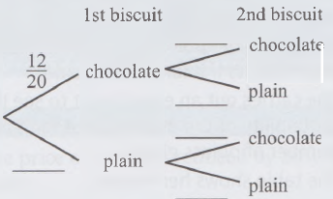
13.6 – More Tree Diagrams
Page 111
7 – Exam-Style Questions
There are 20 biscuits in a tin.
12 of the biscuits are chocolate.
8 of the biscuits are plain.
Hameed takes at random two biscuits from the tin one after the other,
Copy and complete the probability tree diagram.
(2 marks)
Work out the probability that Hameed takes two biscuits of the same type. (3 marks)

Slide 54

13 – Problem Solving
Page 112
Solve problems using these strategies where appropriate:
Use pictures
Use smaller numbers
Use bar models
Use x for the unknown
Use a flow diagram
Use more bar models
Use formulae.
The perimeter of each of these rectangles is 30 cm. How much longer is y than x?

Slide 55
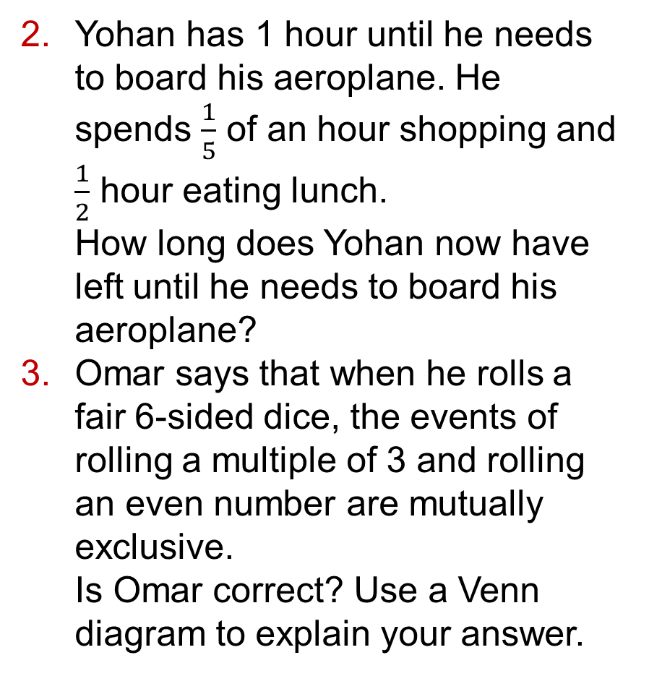
13 – Problem Solving
Page 112
Yohan has 1 hour until he needs to board his aeroplane. He spends $\frac{1}{5}$ of an hour shopping and $\frac{1}{2}$ hour eating lunch.
How long does Yohan now have left until he needs to board his aeroplane?
Omar says that when he rolls a fair 6-sided dice, the events of rolling a multiple of 3 and rolling an even number are mutually exclusive.
Is Omar correct? Use a Venn diagram to explain your answer.

Slide 56
13 – Problem Solving
Page 112
Priya is playing a game. She drops a toy animal and wins points depending on which way it lands.
She gets most points if it lands on its nose and 0 points if it lands on its side.
She carries out an experiment to see if the probability of the event is related to the number of points given.
The table shows her results.
  How many times did Priya drop
  the toy animal?
  What is the experimental
  probability for each of the
  outcomes?
  Do you think the number of points
  relates to the probability of the event?
  Explain your answer.
Outcome | Frequency
Side | 48
Back | 29
Feet | 24
Nose | 9

Slide 57

13 – Problem Solving
Page 112
5 – Exam-Style Questions
A spinner is divided equally into 8 sections. Four sections are coloured blue, three are coloured red and one is coloured yellow,
Write a colour to make each statement correct.
  It is equally likely that the spinner will land on __________, or not on. (1 mark)
  There is a probability of $\frac{1}{8}$ that the spinner will land on ____________. (1 mark)
  It is impossible that the spinner will land on _________. (1 mark)
What is the probability that the spinner will not land on red? (1 mark)

Slide 58
13 – Problem Solving
Page 112
R A fair 6-sided number cube has the following properties.
It has one number on each side.
It has four different numbers.
It has more sides with an odd number on.
It has a probability of ⅓ of rolling a 3.
What could be a possible set of numbers?

Slide 59
13 – Problem Solving
Page 112
Susan has a drawer of coloured socks. She has two blue pairs, one green pair and three purple pairs. None of her socks have been put in pairs. She pulls out one sock at a time.
  What is the probability of pulling out a purple sock?
  What is the probability of not pulling out a green sock?
  Susan picks out a blue sock.
  What is the probability of pulling out a second blue sock?
Q7 hint - Can you draw a diagram to help solve this problem?

Slide 60
13 – Problem Solving
Page 112
R The cross-section of a cuboid is 600 cm². The volume of the cuboid is 24 000 cm³.
The lengths of the sides of the cuboid are in the ratio 1 : 1.5 : 2.
Work out the lengths of the sides.

Slide 61
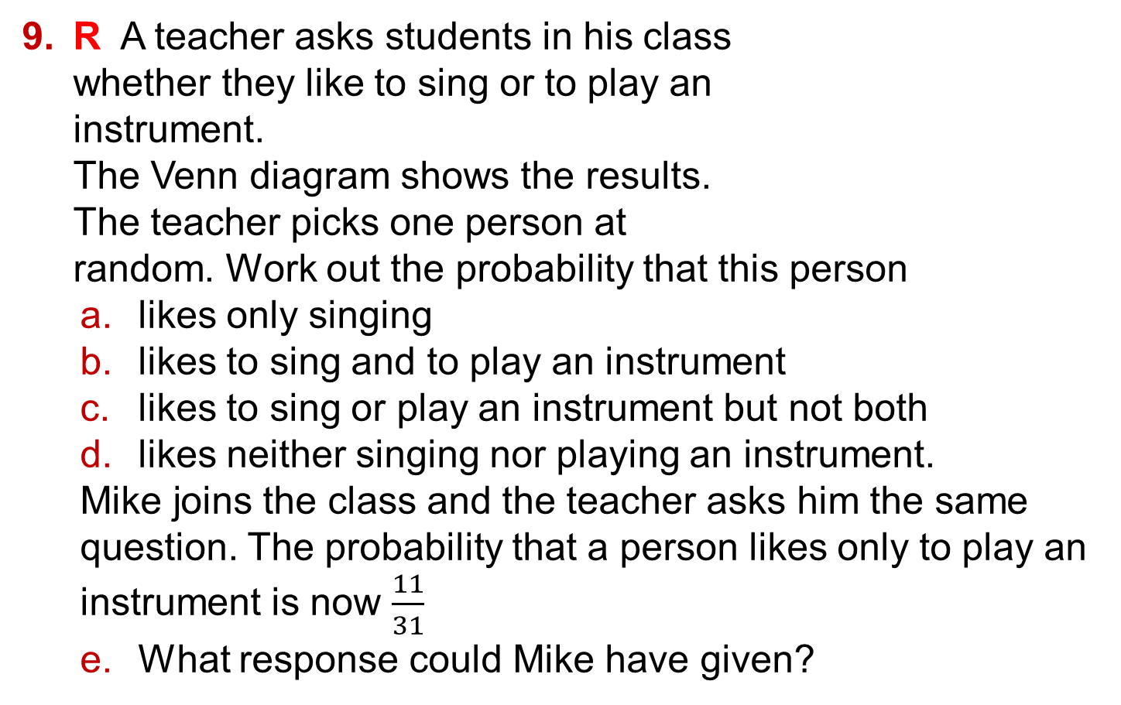
13 – Problem Solving
Page 113
R A teacher asks students in his class
whether they like to sing or to play an
instrument.
The Venn diagram shows the results.
The teacher picks one person at
random. Work out the probability that this person
  likes only singing
  likes to sing and to play an instrument
  likes to sing or play an instrument but not both
  likes neither singing nor playing an instrument.
  Mike joins the class and the teacher asks him the same question. The probability that a person likes only to play an instrument is now $\frac{11}{31}$
  What response could Mike have given?

Slide 62

14.1 – Percentages
Page 113
The price of a washing machine is £450 after 20% VAT is added.
What was the price before VAT was added?
A shop offers a 40% discount in a sale.
A jacket has a sale price of £27.
What was the original price?
A company made 4% more profit in 2014 than in 2013.
In 2014 it made a profit of £1331 200. Flow much profit did
the company make in
2013?

Slide 63
14.1 – Percentages
Page 113
4 – Exam-Style Questions
The price of a bike is reduced by 20% in a sale.
The sale price of the bike is £480.
Work out the original price of the bike. (3 marks)
P Mia buys a laptop that is reduced by 30%. She pays £455.
  What was its original price before the reduction?
  Libby pays £525 for a laptop that is reduced by 25%. Who saves more money?

Slide 64
14.1 – Percentages
Page 114
R George earns £52000 a year.
The first £10000 of his earnings is free of tax. He pays 20% income tax on the next £31865.
He then pays 40% income tax on the rest.
George's employer deducts the tax monthly.
How much tax does George pay each month?
Q6 hint - Taxed pay = £52000 - £10000 = □ Total tax for the year is 20% of £31865 + 40% of (£52 000 - □ - □) To find the tax for a month, divide by □.

Slide 65
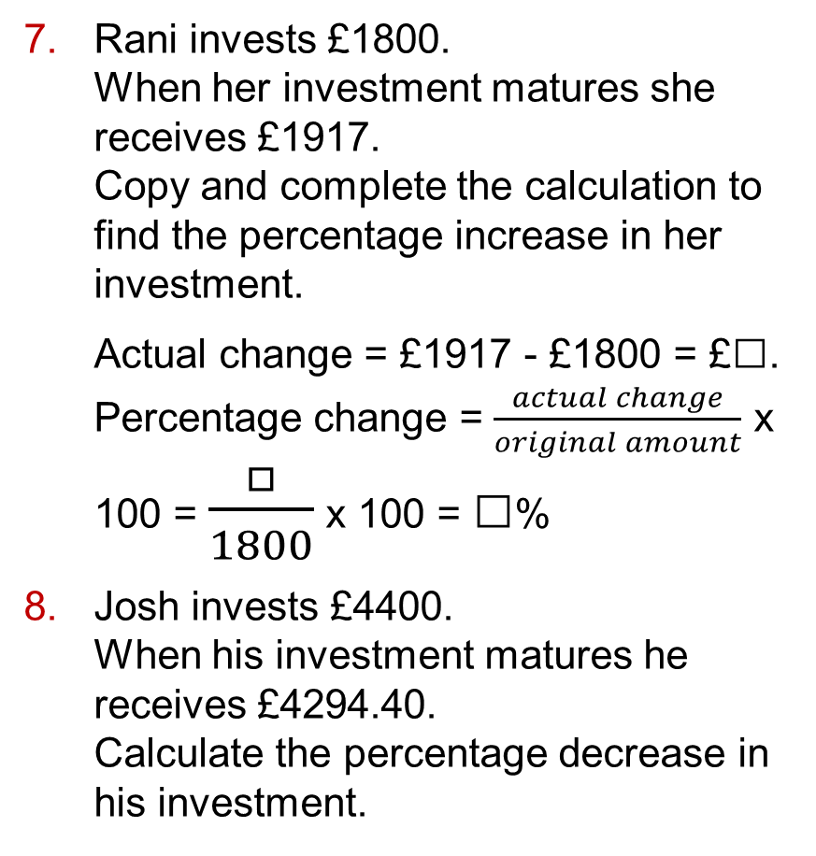
14.1 – Percentages
Page 114
Rani invests £1800.
When her investment matures she receives £1917.
Copy and complete the calculation to find the percentage increase in her investment.
Actual change = £1917 - £1800 = £□.
Percentage change = $\frac{actual change}{original amount}$ x 100 = $\frac{□}{1800}$ x 100 = □%
Josh invests £4400.
When his investment matures he receives £4294.40.
Calculate the percentage decrease in his investment.

Slide 66
14.1 – Percentages
Page 114
Callum invests £2250.
When his investment matures he receives £2288.25.
Work out the percentage increase in his investment.
The table shows the prices a shop pays for some items (cost price) and the prices it sells them for (selling price).
Copy and complete the table to work out the percentage profit on each item.
Item | Cost Price | Selling Price | Actual profit | Percentage Profit
Shirt | £9 | £15
Shoes | £21 | £28
Jeans | £16 | £24
Dress | £30 | £36

Slide 67
14.1 – Percentages
Page 114
Victoria bought a car for £12000.
Two years later she sold it for £9700.
Work out her percentage loss.
Give your answer to 1 d.p.
In 2003 the population of the USA was 288 998 781.
In 2013 it had increased to 315 079 109. What was the percentage increase in the population?
Give your answer to 3 s.f.
P Jai buys 40 books for £3 each.
He sells ½ of them for £7 each, ¼ of them for £5 each and the rest for £3.50 each.
What is his percentage profit?

Slide 68
14.1 – Percentages
Page 114
P / R The table shows information about visitor numbers to a museum in 2013 and in 2014.
  Work out the percentage change in the total number of visitors from 2013 to 2014. Give your answer to 1 d.p.
  Does your answer to part a show a percentage increase or decrease?
  How many adults visited the museum in 2014?
  Work out the percentage change in the amount of money taken in ticket sales from 2013 to 2014.
  Give your answer to 1 d.p.
Year | Total number of visitors | Ratio of children to adults | Price of child tickets | Price of adult tickets
2013 | 14 760 | 1 : 3 | £2.00 | £7.20
2014 | 17 520 | 1 : 2 | £2.50 | £8.00

Slide 69
14.2 – Growth and Decay
Page 114
Sean bought a car for £9000.
It lost 25% of its value in the first year.
It lost 15% of its value in the second year,
  What is the multiplier to find the value of the car at the end of the first year?
  What was the value of the car at the end of the first year?
  What is the multiplier to find the value of the car at the end of the second year?
  What was the value of the car at the end of the second year?
  What is the single decimal number that the original value of the car can be multiplied by to find its value at the end of the 2 years?

Slide 70
14.2 – Growth and Decay
Page 115
Raj has a job with an annual salary of £18000. At the end of the first year he is given a salary increase of 1.5%.
At the end of the second year he is given an increase of 2%.
  Write the single number, as a decimal, that Raj's original salary can be multiplied by to find his salary at the end of the 2 years,
  Work out Raj's salary at the end of 2 years.
R Georgia says, 'An increase of 10% followed by an increase of 18% is the same as an increase of 28%.‘
Is Georgia correct? Explain your answer.

Slide 71
14.2 – Growth and Decay
Page 115
Jamie's manager says he can have either a 1% pay rise this year and then a 2.5% pay rise next year, or a 2% pay rise this year.
Which is the better offer? Explain.
P £4000 is invested for 2 years at 3% per annum compound interest.
Work out the total interest earned over the 2 years.
£1700 is invested for 2 years at 2.5% per annum compound interest.
Work out the total amount
in the account after 2 years.

Slide 72
14.2 – Growth and Decay
Page 115
£1200 is invested at 2% compound interest.
Copy and complete the table.
There are 1500 bacteria in a Petri dish.
The number of bacteria doubles every hour. How many bacteria will be in the dish after 6 hours?
Year | Amount at start of year | Amount plus interest | Total amount at end of year
1 | £1200 | 1200 x 1.02 | £1224.00
2 | £1224 | 1224 x 1.02 = 1200 x 1.02² | £1248.00
3 | £1248.48 | 1248 x 1.02 = | £
4 | £1273.45 |  | £

Slide 73
14.2 – Growth and Decay
Page 115
Work out the multiplier, as a single decimal number, that represents
  an annual increase of 12% for 2 years
  an annual decrease of 10% for 5 years
  an increase of 7% followed by an increase of 3%
  a decrease of 15% followed by a decrease of 8%
  an increase of 11% followed by a decrease of 4%.

Slide 74
14.2 – Growth and Decay
Page 115
The level of activity of a radioactive source decreases by 10% per day.
The activity is 5000 counts per minute. What will it be a week later?
The level of activity of a sample containing a radioactive isotope is 90 000 counts per minute.
The half-life is 3 days.
What will the count rate be after 12 days?
Q11 hint - The half-life is the time taken for the count rate to fall to half its starting value.

Slide 75
14.2 – Growth and Decay
Page 115
In 2014 a supermarket chain had 120 stores in the UK. The number of stores increases at a rate of 6% each year.
How many stores will it have in 2018?
13 – Exam-Style Questions
Liz makes an investment which will increase in value by 5% every year,
Liz says, ‘After 10 years my investment will be worth 50% more than it is now.’ Liz is wrong. Explain why.
(1 mark)
Liz wants to work out the value of her investment after 2 years,
By what single decimal number should Liz multiply the value of the initial investment? (2 marks)

Slide 76
14.3 – Compound Measures
Page 115
R Will has a basic pay rate of £8.80 per hour. He is paid 1.5 times as much for every hour he works at the weekend and twice as much for every hour he works at night.
One week, Will works for 20 hours at his basic pay rate, 5 hours at the weekend and 8 hours at night.
How much does he get paid for the week?
A block of lead has a mass of 1.5 kg and a volume of 130cm³.
What is its density in g/cm³?

Slide 77
14.3 – Compound Measures
Page 116
Water leaks from a tank at a rate of 2 litres per hour.
  Work out how much water leaks from the tank in
    30 minutes
    45 minutes.
  Initially there are 70 litres of water in the tank.
  Work out how long it takes for all the water to leak from the tank.
A cubic metre of sand weighs 1500 kg. What is the density of the sand in g/cm³?

Slide 78
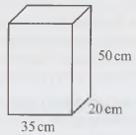
14.3 – Compound Measures
Page 116
3 – Exam-Style Questions
The diagram shows a fuel
tank in the shape of a
cuboid.
The measurements of the
cuboid are 35 cm by
20 cm by 50 cm.
Work out the volume of the tank.
(1 mark)
Fuel is drained from the tank at a rate of 4 litres per minute.
1 litre = 1000 cm3
Work out the time it takes to empty the tank completely. Give your answer in minutes. (2 marks)

Slide 79
14.3 – Compound Measures
Page 116
A car travels 500 km and uses 40 litres of petrol.
  Work out the average rate of petrol usage.
  State the units with your answer,
  Estimate the amount of petrol used when the car has travelled 75 km.
A piece of copper
has a mass of 2.8 kg.
Work out its volume.

Slide 80
14.3 – Compound Measures
Page 116
R 1 cm³ of tin has a mass of 7.37g.
1 cm³ of nickel has a mass of 8.91 g.
  Write down the density of each metal.
  Which metal is more dense?
  Explain your answer.
A piece of aluminium has volume 450cm³ and density 2.7 g/cm³.
Work out the mass of the aluminium.
Give your answer in
  grams b kilograms.

Slide 81
14.3 – Compound Measures
Page 116
10 – Exam-Style Questions
The diagram shows a triangular prism.
The base of the triangle is 8 cm and its height is 4 cm.
The length of the prism is 12 cm.
Work out the volume of the prism.
(3 marks)
The prism is made out of silver.
Silver has a density of 10.5 grams per cm³,
Work out the mass of the prism.
Give your answer in kilograms.
(2 marks)

Slide 82
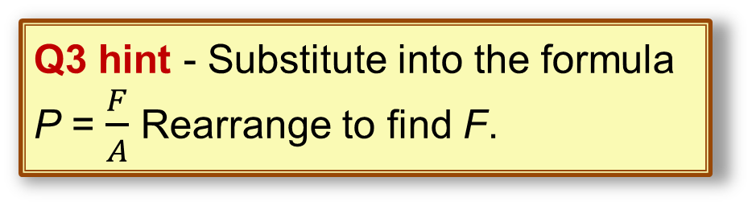
14.3 – Compound Measures
Page 116
a A force F of 50 N is applied to an area A of 1.4 m². Work out the pressure P in N/m².
  A force applied to an area of 3.2 m² produces a pressure of 18 N/m².
  Work out the force in N.
Copy and complete the table.
Q3 hint - Substitute into the formula P = $\frac{F}{A}$ Rearrange to find F.
Force (N) | Area (m²) | Pressure (N/m²)
90 | 2.4
60 |  | 9
 | 7.5 | 16

Slide 83
14.4 – Distance, Speed and Time
Page 117
Copy and complete the table.
Work out the average speed for these journeys.
  A plane flies 750 miles in 1½ hours,
  A cyclist rides 27 miles
  in 2 hours 15 minutes.
  A car travels 250 km in
  3 hours 12 minutes.
Distance (km) | Speed (km/h) | Time
105 |  | 1h 30min
 | 88 | 3h 15min
168 | 72

Slide 84
14.4 – Distance, Speed and Time
Page 117
Work out the distance travelled for these journeys.
  A train travels for 2 hours 40 minutes at an average speed of 120 km/h.
  A helicopter flies for 45 minutes at an average speed of 90 mph.
  A man runs for 12 minutes at an average speed of 8.5 km/h.
Work out the time taken for these journeys,
  A leopard walks 21 km at an average speed of 3.5 km/h.
  A bee flies 0.25 km at an average speed of 5 m/s.
  An ant walks 36 m at an average speed of 3 cm/s.

Slide 85
14.4 – Distance, Speed and Time
Page 117
Convert these speeds from metres per second (m/s) to metres per hour (m/h).
  5 m/s b. 16 m/s c. 3 m/s
Hannah travels the first 80 km of a journey in 50 minutes. She then travels a further 30 km in half an hour.
What is her average speed for the whole journey?
Peter walks 864 m from his house to school. The journey takes him 9 minutes.
What is his average speed in m/s?

Slide 86
14.4 – Distance, Speed and Time
Page 117
8 – Exam-Style Questions
On Saturday Laura cycles for 3 hours.
Her average speed is 26 km/h.
How far does Laura cycle on
Saturday? (2 marks)
On Sunday Laura cycles 55 miles.
5 miles = 8 kilometres
On which day did Laura cycle
further? (3 marks)
Convert these speeds from metres per second (m/s) to kilometres per hour (km/h).
  10 m/s b. 3 m/s c. 12 m/s

Slide 87
14.4 – Distance, Speed and Time
Page 117
Convert these speeds from kilometres per hour (km/h) to metres per second (m/s).
  18 km/h b. 90 km/h
  63 km/h
A high-speed train has a top speed of 70 m/s. What is this speed in km/h?
P/R A swordfish can swim at up to 100 km/h.
A cheetah can run at a top speed of 30 m/s. Which is faster? Explain your answer.

Slide 88
14.4 – Distance, Speed and Time
Page 117
Use the formula v = u + at to work out v when
  u = 5, a = 3 and t = 6
  u = 15, a = 1.5 and t=8
Use the formula v = u + at to work out u when
  v = 11, a = 2 and t = 4
  v = 20, a = 2.5 and t = 6
Use the formula v = u + at to work out a when
  v = 9, u = 1 and t = 4
  v = 12, u = 5 and t= 14

Slide 89
14.4 – Distance, Speed and Time
Page 117
Copy and complete the table using the formula s = ut + ½at².
S (m) | u (m/s) | a (m/s²) | t (s)
6 |  | 4 | 1
9 | 7 |  | 1
18 |  | 5 | 2
24 | 5 |  | 3

Slide 90
14.4 – Distance, Speed and Time
Page 118
Copy and complete the table using the formula v² = u² + 2as.
A car starts from rest and accelerates at 3 m/s² for 250 m.
  Write down the values of u, a and s.
  Using the formula in Q17, work out the final velocity in m/s.
v (m/s) |  | 10 | 7 | 10 | 9
u (m/s) | 6 |  | 6 |  | 5
a (m/s) | 2 | 3 |  | 3
s (m/s) | 7 | 6 | 5 | 8.5 | 7

Slide 91
14.4 – Distance, Speed and Time
Page 118
R The table shows the distance d travelled by a car over a period of time t.
  Write the ratios for the pairs of values in the table.
  Is of in direct proportion to £?
  Explain your answer.
  Write a formula that shows the relationship between distance d and time t. d Use your formula to work out the distance travelled after 20 minutes.
Distance, d (km) | 6 | 12 | 18 | 24 | 30
Time, t (minutes) | 8 | 16 | 24 | 32 | 40

Slide 92
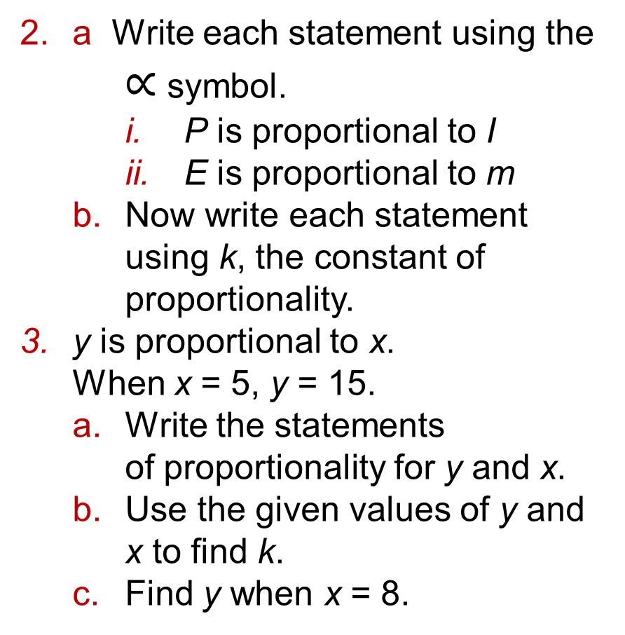
14.4 – Distance, Speed and Time
Page 118
a Write each statement using the $∝$ symbol.
    P is proportional to I
    E is proportional to m
  Now write each statement using k, the constant of proportionality.
y is proportional to x.
When x = 5, y = 15.
  Write the statements
  of proportionality for y and x.
  Use the given values of y and x to find k.
  Find y when x = 8.

Slide 93
14.4 – Distance, Speed and Time
Page 118
c is directly proportional to r.
When r = 8, c= 14.
  Write a formula for c in terms of r.
  Find c when r = 6.
The number of pounds P is directly proportional to the number of dollars D.
  One day $1 = £0.60
  Write a formula connecting P and D.
  Use your formula to convert $120 to £.

Slide 94
14.4 – Distance, Speed and Time
Page 118
R X and Y are in inverse proportion. Copy and complete the table.
Write down whether each of these equations represents direct proportion, inverse proportion or neither.
  y = 3x b. x + y = 10
  x – y = 2 d. y = 7 + x
  xy = 8
X | 10 | 20 | 24
Y | 12 |  |  | 80 | 16
Q6 hint - AY = constant when X and Y are in inverse proportion.

Slide 95
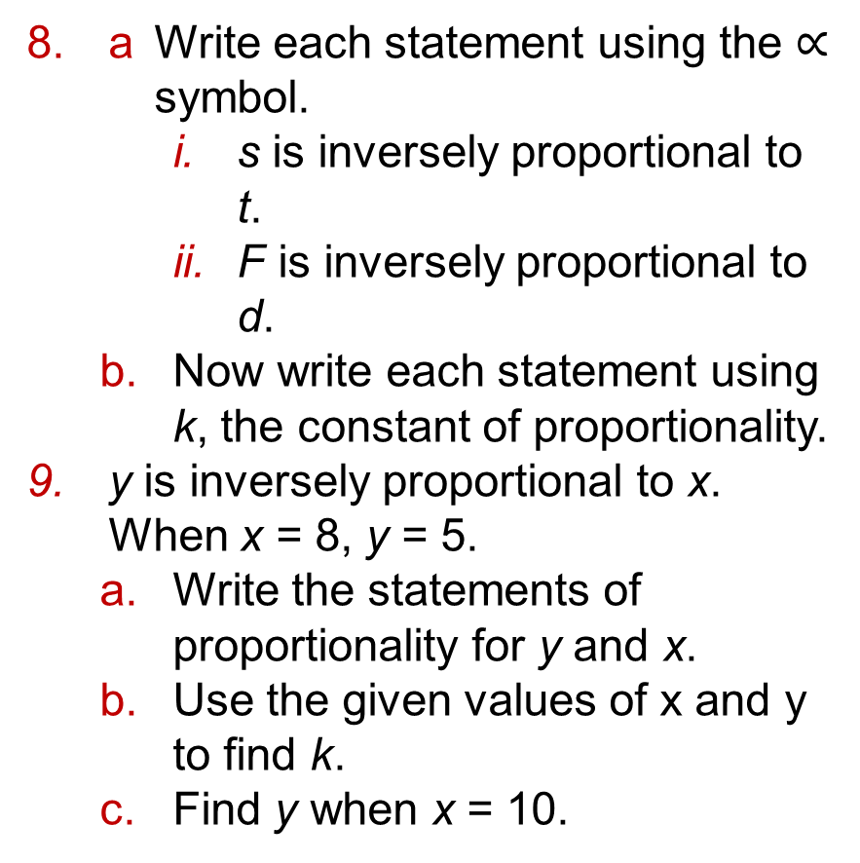
14.4 – Distance, Speed and Time
Page 118
a Write each statement using the $∝$ symbol.
    s is inversely proportional to t.
    F is inversely proportional to d.
  Now write each statement using k, the constant of proportionality.
y is inversely proportional to x.
When x = 8, y = 5.
  Write the statements of proportionality for y and x.
  Use the given values of x and y to find k.
  Find y when x = 10.

Slide 96
14.4 – Distance, Speed and Time
Page 118
10 – Exam-Style Questions
a is inversely proportional to b.
a = 50 when b = 0.8
Calculate the value of a when
b = 2.5 (3 marks)
The time t it takes to build a house is inversely proportional to the number of builders b.
It takes 60 days for 8 builders to build a house.
How many builders would be needed to build the house in 24 days?

Slide 97

14 – Problem-solving
Page 119
Solve problems using these strategies where appropriate:
Use pictures
Use smaller numbers
Use bar models
Use x for the unknown
Use a flow diagram
Use more bar models
Use formulae.
The perimeter of
this shape is 72cm.
Work out the value
of y.

Slide 98
14 – Problem-solving
Page 119
Micah puts a fence round the edge of his garden, which is a rectangle. He uses 24m of fencing in total. The width of his garden is 4 m less than the length. How much fencing does Micah use for one of the longer sides of his garden?
R Rita is selecting a sample of her employees. She selects the 10 employees who sit closest to her.
Is Rita taking a random sample of her employees? Explain your answer.
Q2 hint - Create a formula using X for one side of the garden.

Slide 99
14 – Problem-solving
Page 119
Georgie is shopping online. She is comparing prices between UK and USA stores.
The exchange rate is about 1.5 dollars ($) to the pound (£). The table shows the prices she found, including shipping fees.
Georgie ordered each item from the country with the better deal.
Which country did she order each item from?
Item | UK (£) | USA ($)
Boots | 125 | 145
Make-up | 35 | 62
Jacket | 147 | 200
Bag | 59 | 97

Slide 100
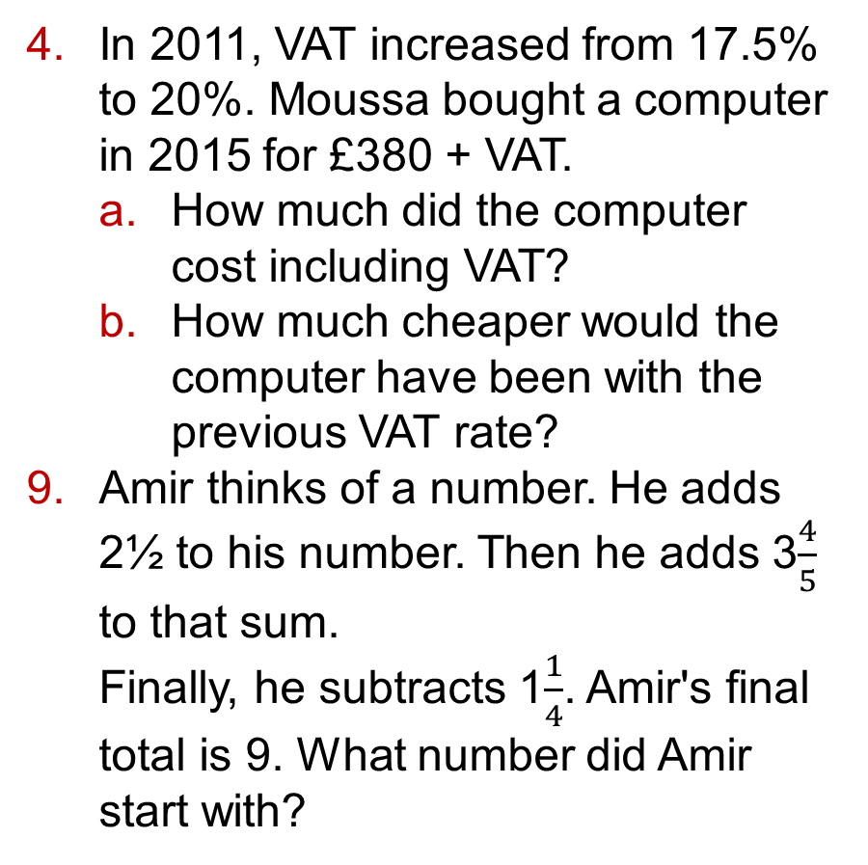
14 – Problem-solving
Page 119
In 2011, VAT increased from 17.5% to 20%. Moussa bought a computer in 2015 for £380 + VAT.
  How much did the computer cost including VAT?
  How much cheaper would the computer have been with the previous VAT rate?
Amir thinks of a number. He adds 2½ to his number. Then he adds 3$\frac{4}{5}$ to that sum.
Finally, he subtracts 1$\frac{1}{4}$. Amir's final total is 9. What number did Amir start with?

Slide 101
14 – Problem-solving
Page 119
The total land area of Great Britain is 229 848 km². The total land area of the county of Yorkshire is 11903 km².
  What percentage of the land area of Great Britain is covered by Yorkshire?
  Give your answer to 3 significant figures,
  The county of Cumbria covers 2.94% of Great Britain's total land area. Approximately how many square kilometres is it?
  Give your answer to 3 significant figures.

Slide 102
14 – Problem-solving
Page 119
R Kayla and her friends are putting packets of pasta into packing boxes. A single packet of pasta has dimensions 15cm x 20cm x 6cm. The packing boxes measure 45 cm x 40cm x 60cm.
  12 packing boxes are filled to capacity with packets of pasta.
  How many packets have they packed?
  Show how you worked it out.
  Jacob and his friends are using the same size packing boxes for packets of rice.
  A single packet of rice has dimensions 15cm x 20cm x 5cm. 11 packing boxes are filled with packets of rice.
  Which group of friends has packed more packets? Show how you worked it out.

Slide 103
14 – Problem-solving
Page 119
R Raul is baking a cake. His recipe gives the ingredients in ounces but his scales only weigh in grams. He knows that 6 ounces is about 170 grams.
  What ratio would Raul need to calculate to convert the measurements from ounces to grams?
  Make a conversion chart that shows the conversions from ounces to grams for weights from 1 to 12 ounces,
  Explain why Raul's chart is not exact.
10 – Exam-Style Questions
Michael wants to buy a flight to Spain.
He finds a sale price of £143. The sale gives him 35% off the original price. What was the original price of the flight? (3)

Slide 104


15.1 – 3D Solids
Page 120
Here is a child's
building brick.
  How many
  faces does the brick have?
  How many edges does it have?
2 – Exam-Style Questions
Here is a cube.
Copy and complete each
of the following sentences
by inserting the correct
number,
A cube has __________ faces.
A cube has __________ vertices.
A cube has. __________ edges. (3)

Slide 105


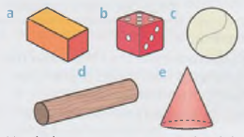
15.1 – 3D Solids
Page 120
Here is a triangular
prism,
  What are the
  names of the
  shapes of its faces?
  Write down the dimensions of each of the faces.
Here are some three-dimensional solids,
Match the correct name to each solid, cylinder sphere cube cone cuboid
4

Slide 106



15.1 – 3D Solids
Page 120
R Here are some three-dimensional shapes. They are all pyramids or prisms.
  What shapes are the faces of the square-based pyramid?
  What shapes are the faces of the octagonal prism?

Slide 107
15.1 – 3D Solids
Page 120
  Copy and complete the table.
  Write a rule connecting the number of edges (E), vertices (1V) and faces (F).
  A 3D shape has 12 faces. Use your rule to work out the number of edges and vertices the shape has.
  Does your rule work for all of the shapes in Q4?
Shape | No. of Edges | No. of Vertices | No. of Faces
Cuboid
Cube
Tetrahedron
Octagonal prism
Triangular prism
Square based pyramid
Q5d hint - Add together the number of faces and vertices and compare this with the number of edges.
Q5e hint A decagon has 10 sides, so the cross-section of a decagonal prism will have 10 sides.

Slide 108
15.1 – 3D Solids
Page 120
R Jacob says, ‘A 3D solid can only have fewer vertices than faces if it has curved edges.’
Is he correct? Explain your answer.

Slide 109

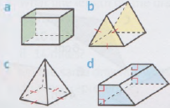
15.2 – Plans and Elevations
Page 121
Copy the diagrams and
draw in all the planes of
symmetry for each shape.
R A cake is made in
the shape of a
5-pointed star.
How many ways can
the cake be cut into equal halves?

Slide 110

15.2 – Plans and Elevations
Page 121
A rolled steel joist
(RSJ) is moulded
in this shape.
The RSJ is a prism
and the cross-section of the RSJ is an H-shape.
The RSJ has three planes of
symmetry. Copy the diagram
and draw in the three planes
of symmetry.
Draw the plan view, the front elevation and side elevation of these
cuboids on squared paper.

Slide 111

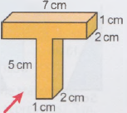
15.2 – Plans and Elevations
Page 121
Here are the plan views of some solids.
Name two possible solids that each could be.
On squared paper, draw the plan,
front elevation
(shown by the
arrow) and
side elevation
of this prism.

Slide 112
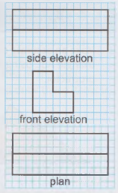
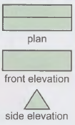

15.2 – Plans and Elevations
Page 121
Here are the plan, front elevation and side elevation views of a prism, drawn on cm squared paper. Sketch the prism. Label its lengths.
Here are the plan, front elevation and side elevation views of a prism. Sketch the prism.

Slide 113


15.2 – Plans and Elevations
Page 121
Here is a cuboid.
Draw an accurate diagram of
  the side elevation (shown by the arrow)
  the plan view.
10 – Exam-Style Questions
Here are the front elevation, side elevation and plan of a 3D shape.
Draw a sketch of the 3D shape. (2 marks)

Slide 114

15.2 – Plans and Elevations
Page 121
This diagram shows a building in the shape of a prism.
Draw a sketch of the plan view of the building.
Show the
dimensions
of the plan
on your
sketch.
Q11 hint - Imagine you are flying over the building directly above it. When you look down, what shape do you see? The shape of the top of the building or the shape of the bottom?

Slide 115
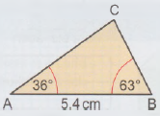
15.3 – Accurate Drawings 1
Page 122
Make an accurate drawing of triangle ABC using a ruler and protractor.

Slide 116
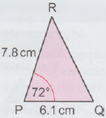
15.3 – Accurate Drawings 1
Page 122
Make an
accurate
drawing of
triangle PQR
using a ruler
and
protractor.
Q2 hint - Start by drawing and labelling the line PQ, and then mark the angle RPQ from point P using a protractor. Next, accurately draw the line PR from P through the marked point and label the end of this line R. Finally, join Q and R with a straight line to complete your triangle.

Slide 117
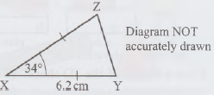
15.3 – Accurate Drawings 1
Page 122
3 – Exam-Style Questions
The diagram shows a sketch of isosceles triangle XYZ.
Make an accurate drawing of triangle XYZ. (2 marks)
Measure the length of side YZ. (1 mark)

Slide 118
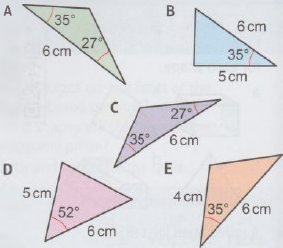
15.3 – Accurate Drawings 1
Page 122
R a Which of these five triangles are ASA triangles and which are SAS triangles?
  Make accurate drawings of all the triangles using a ruler and protractor,
  Which two triangles are congruent?

Slide 119

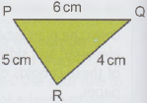
15.3 – Accurate Drawings 1
Page 122
Make an accurate drawing of triangle ABC using a ruler and pair of A compasses.
Use compasses and a ruler to draw an
accurate
diagram of
this sketch

Slide 120
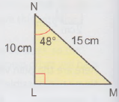
15.3 – Accurate Drawings 1
Page 122
Make an accurate drawing of an isosceles triangle with two sides of length 4cm and one side of length 6cm.
a Make an accurate n drawing of triangle LMN.
b How long
is side
LM?

Slide 121
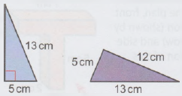
15.3 – Accurate Drawings 1
Page 122
R Here is a sketch of an RHS triangle and an SSS triangle.
  Construct the two triangles shown,
  Are the triangles congruent?

Slide 122
15.4 – Scale Drawings and Maps
Page 123
On a scale drawing, 1 cm represents 5 miles,
  What line length on the
  drawing represents
    10 miles
    14 miles?
  On the same drawing, what actual length do these represent?
    3 cm
    4.2 cm
A scale drawing of a rectangular garden has a scale of 1:50.
  The length of the garden in the plan is 40 cm. How tong is the actual garden?
  The width of the actual garden is 12 m. What is the width of the garden on the plan?

Slide 123
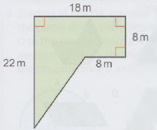
15.4 – Scale Drawings and Maps
Page 123
Here is a sketch of a plot of land.
On cm squared paper, draw a scale diagram of the plot using the scale 1cm represents 2 m.

Slide 124
15.4 – Scale Drawings and Maps
Page 123
This diagram shows a scale plan of a swimming pool
drawn on squared paper. The steps are 2 m by 3 m.
  Copy and complete the statement.
  1 cm on the diagram represents □ m.
  Write the scale used as a ratio 1: x.
  Use the scale to work out
    the dimensions of the shallow end
    the dimensions of the deep end
    the total surface area
    of the pool.
  Copy the diagram and draw
  these items in the pool.
    a large floating mat
    measuring 1 m by 2.5 m
    a slide measuring 1.5 m by 4 m

Slide 125
15.4 – Scale Drawings and Maps
Page 123
On a scale diagram, 4 cm represents a real-life length of 1.2 m.
  Write the two lengths as a ratio of scale diagram: real life,
  Write as a ratio in the form 1: m.
A landscape gardener makes a scale drawing of a garden using a scale of 1: 20.
She digs a flowerbed measuring 4 m by 0.5 m.
  What are the dimensions of the flowerbed on the scale drawing?
  A path on the scale drawing is 55 cm long. How long is it in real life?

Slide 126
15.4 – Scale Drawings and Maps
Page 123
Here is a map of part of Wales. The map has a scale of 5 cm : 100 km.
  Using the map, work out the distance from
      Cardigan to Swansea
      Swansea to Cardiff
      St David's to Brecon.
  Which town is 19 km north of Swansea?

Slide 127
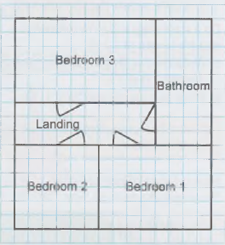
15.4 – Scale Drawings and Maps
Page 124
R An estate agent draws a scale diagram of the upstairs of a house. The dimensions are
    Bedroom 1 4 m by 3 m
    Bedroom 2 3 m by 3 m
    Landing 1.5 m by 4m
    Bedroom 3 3 m by 4 m
    Bathroom 3m by 4.5m
    All doors are 1 m wide.
  This scale diagram is incorrect. Explain why.
  Draw a correct version of the diagram on squared paper.

Slide 128
15.4 – Scale Drawings and Maps
Page 124
R An architect is designing an extension and wants to draw a scale diagram of it on a sheet of A3 paper.
The dimensions of the extension are 4 m by 7.5 m.
Which of these scales should the architect use to draw the scale diagram? Explain why.
A 1:20 B 1:200 C 1:10 D 1:5 E 1:100
The scale factor on a map is 1: 250 000.
  What distance in metres does 10 cm represent?
  What distance in kilometres does 12 cm represent?
  How many centimetres on the map is a real distance of 35 km?

Slide 129
15.4 – Scale Drawings and Maps
Page 124
R The scale on an Ordnance Survey map is 1: 50 000.
  What length on the map would a 12 km walk be?
  How many km would a walk represented by a length of A0 cm be?
R Three phone masts are arranged like this: Mast A is 60 km south of Mast B.
Mast C is A5 km northwest of Mast B.
  Draw a scale drawing showing these three masts. Use a scale of 1 cm to 10 km.
  Mast D is placed 65 km east of Mast A.
  Draw Mast D on your diagram,
  Use your diagram to find the distance from
    Mast C to Mast D
    Mast A to Mast C.

Slide 130
15.5 – Accurate Drawings 2
Page 124
R Which of these are not a net of a tetrahedron?
Using compasses, make an accurate drawing of triangle PQR where PQ = 9.2 cm,
QR = 7.6 cm and PR = 3.1 cm.

Slide 131
15.5 – Accurate Drawings 2
Page 124
In triangle ABC, AB = 7.A cm, BC = 5.9 cm and angle ABC = 62°.
  Draw a sketch of triangle ABC showing all three given measurements,
  Now make an accurate drawing of triangle ABC.
  Measure the size of angle CAB.

Slide 132
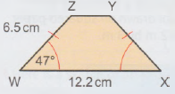
15.5 – Accurate Drawings 2
Page 124
Here is an isosceles trapezium, WXYZ.
  Make an accurate drawing of this trapezium.
  Measure the length of side YZ.
  Measure the size of angle XYZ.

Slide 133
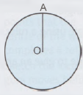
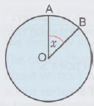
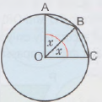
15.5 – Accurate Drawings 2
Page 125
Follow these instructions to construct a regular octagon inside a circle,
  Draw a circle with radius 8 cm. Label the centre O.
  Draw a vertical line from O up to a point on the circumference. Label this point A.
  To work out the angle you need to measure in the middle, divide 360° by the number of sides of an octagon. Call this angle x.
  Starting at line OA, measure angle x at the centre of the circle. Draw a line from O to the circumference through your measured angle. Label the new point on the circumference B and the angle x.
  Join points A and B together with a straight line. Line AB is the first side of your octagon.
  Repeat parts d and e until you have drawn the whole octagon.

Slide 134
15.5 – Accurate Drawings 2
Page 125
ABCD is a cyclic quadrilateral. 0 is the centre. OA = OB = OC = OD = 7 cm.
Angle AOB = 112° and angle BOC = 76°.
Angle COD = angle DOA.
  Using a ruler, compasses and a protractor, draw polygon ABCD.
  Using your diagram, measure angle COD and the length of the line DA.
Q6 hint - A cyclic quadrilateral is a four-sided polygon whose vertices are all on the circumference of a circle.

Slide 135
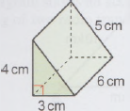

15.5 – Accurate Drawings 2
Page 125
On squared paper, draw an accurate net for this triangular prism.
P A packaging company makes small boxes in the shape of a triangular prism.
Use a ruler and compasses to draw a scaled diagram of an accurate net for the box.
Use a scale of 1 cm to represent 3 cm.

Slide 136



15.6 – Constructions
Page 125
a Use a ruler and compasses to construct the perpendicular bisector of a line 13 cm long.
  Check, by measuring,
  that your line cuts the
  original line exactly in
  half.
AB = 10 cm. C is 5 cm above the line AB.
  Construct the line AB and mark one possible position of C.
  Using a ruler and compasses, construct a perpendicular
  line to AB which passes
  through point C.

Slide 137
15.6 – Constructions
Page 125
a Construct triangle PQR where
PQ = 5 cm, QR = 4 cm and
RP = 2 cm.
  Mark a point X somewhere inside the triangle.
  Accurately construct the line that shows the shortest distance from X to the line PR. Measure this line.
a Draw a horizontal line.
  Use your compasses to draw arcs on the line to find the midpoint of the line segment between the arcs,
  Construct the perpendicular bisector for this new line segment.

Slide 138
15.6 – Constructions
Page 126
R A, B and C
are three
railway stations.
The railway company wishes to build a track from C to the line AB. The new track must be the shortest length possible,
  Draw the diagram using a scale of 1 cm to 2 km and construct on the new track using a ruler and compasses,
  How long will the new track be in km?

Slide 139

15.6 – Constructions
Page 126
R a Draw an angle of 80° using a protractor.
Construct the angle bisector,
  Check, by measuring with
  a protractor, that your
  angle bisector cuts the
  angle exactly in half.
Copy the diagrams. Then construct the bisector of angle B in each triangle.

Slide 140
15.6 – Constructions
Page 126
8 – Exam-Style Questions
Copy this angle and then use a ruler and compasses to construct the bisector of the angle.
You must show all your
construction lines.
(2 marks)
Exam hint
Use the equipment they tell you to use. Using a protractor for this question gains no marks.

Slide 141

15.5 – Accurate Drawings 2
Page 126
Draw a 125° angle and construct its angle bisector.
R How could you
use your
knowledge of
constructing
perpendicular
bisectors and angle bisectors to find the exact height of this triangle?
a Construct a right angle using a ruler and a pair of compasses.
  Bisect your right angle to give an angle of 45°.

Slide 142
15.7 – Loci and Regions
Page 126
Mark a point A on a piece of paper.
What is the locus of points that are 7 cm from point A?
R Two points Q and R are 6 cm apart,
  Draw points Q and R.
  A point 5 moves so that it is always equidistant (the same distance) from Q and R.
  Construct the locus of point S.
a Draw a line 10 cm long.
  A point moves so that it is always 3 cm away from the tine segment.
  Construct the locus.

Slide 143
15.7 – Loci and Regions
Page 126
a Draw a 70° angle, PQR. Make each arm of the angle at least 5 cm long.
  Sketch the locus of points that are exactly the same distance from PQ and QR.
  Construct the locus accurately on your diagram using a ruler and compasses.

Slide 144

15.7 – Loci and Regions
Page 126
PQRS is an isosceles trapezium.
  Copy the diagram and draw the locus of points that are equidistant from P and Q.
  Draw the locus of points that are equidistant from the lines SR and SP.
  Mark the intersection of the loci with a cross X.

Slide 145
15.7 – Loci and Regions
Page 127
R Chewing gum is stuck on a bicycle wheel.
The wheel travels through 4 complete rotations
before the gum
comes off.
  Sketch the locus of points that the centre of the wheel moves as the wheel completes 4 rotations.
  Sketch the locus of points that the chewing gum moves before it falls off.

Slide 146

15.7 – Loci and Regions
Page 127
A rectangular piece of card is placed on a horizontal surface.
  The card is first
  rotated 90°
  clockwise about
  vertex Z. Copy or
  trace the diagram in colour 1. Draw the new position of the rectangle in one colour. Draw the locus of the vertex W in a second colour.
  The card is then rotated 90° clockwise about vertex Y and then 90° clockwise about vertex X. Draw the new positions of the card in your first colour and the remainder of the locus of vertex W in your second colour.

Slide 147
15.7 – Loci and Regions
Page 127
R Match each locus to the correct description.
  The shaded region represents the area which is less than 4 cm from point X.
  The shaded region represents the area which is less than 6 cm from point Y.
  The shaded region represents the area which is less than 4 cm from X and less than 6 cm from Y.

Slide 148

15.7 – Loci and Regions
Page 127
9 – Exam-Style Questions
The diagram shows an accurate scale drawing of two radio transmitter masts.
Both masts can transmit up to 20 km.
Copy the diagram and shade the region in which you can pick up a signal from both transmitters. (3 marks)

Slide 149

15.7 – Loci and Regions
Page 127
P A dog is tied by a 10 m rope to the corner of a shed which measures 7 m by
Copy the diagram and shade in the area where the dog can roam.

Slide 150

15.7 – Loci and Regions
Page 127
Two lighthouses are 120 km apart on a stretch of coastline.
A third lighthouse is being built exactly halfway between the two lighthouses on the coast.
Draw a scale diagram, using a scale of 1 cm : 12 km and mark the position of the new lighthouse.
Q11 hint - Construct the perpendicular bisector of the line joining the lighthouses.

Slide 151

15.7 – Loci and Regions
Page 128
12 – Exam-Style Questions
The diagram
shows a field.
The scale of the
diagram is 1 cm
represents 20 m.
A sprinkler is being installed.
The sprinkler must be nearer to PS than QR and within 20 m of the point P.
Copy the diagram and shade the region where the sprinkler may be placed. (3 marks)

Slide 152
15.8 – Bearings
Page 128
Write the bearing of B from A in these diagrams.
The bearing of B from A
is 137°.
Work out the bearing of
A from B.

Slide 153
15.8 – Bearings
Page 128
3 – Exam-Style Questions
Work out the bearings of M from L.
(3 marks)

Slide 154


15.8 – Bearings
Page 128
4 – Exam-Style Questions
Work out the
bearing of
Y from X
X from Z.
(4 marks)
Draw these bearings accurately. Use the scale 1 cm : 25 km.
  Petersfield is 200 km from Lottisham on a bearing of 035°.
  Steep is 150 km from Gunport on a bearing of 149°.

Slide 155
15.8 – Bearings
Page 128
On a camp site Amy pitches her tent 300 m from the shower block on a bearing of 160°. The kitchen is 200 m from the tent on a bearing of 75°.
  Draw an accurate diagram marking the positions of Amy's tent, the shower block and the kitchen. Use a scale of 1 cm : 50 m. Use your diagram to find
  the distance between the shower block and the kitchen
  the bearing of the kitchen from the shower block
  the bearing of the shower block from the kitchen.

Slide 156
15.8 – Bearings
Page 128
P Two lifeboat stations are at points A and B on a coastline. The stations are 20 km apart. They both receive a distress call from a sinking ship.
The ship is on a bearing of 112° from A and 230° from B.
  Draw an accurate diagram of the lifeboat stations and mark the position of the ship. Use a scale of 1 cm : 2 km.
  Find the bearing of the lifeboat station at B from the ship.
  How far, to the nearest km, is the ship from the closer lifeboat station?
Q7a hint - Draw the lifeboat stations at A and B first, then draw in the bearings to the sinking ship. The ship's position will be where your two bearing lines intersect. Remember to use the scale carefully.

Slide 157

15.8 – Bearings
Page 129
P Two boats A and B are racing to the finishing buoy. A is 500 m from B on a bearing of 320°. B is 300 m from the finishing buoy.
  Draw an accurate diagram of the positions of the two boats and the buoy.
  Use your diagram to find
    the distance of boat A from the finishing buoy
    the bearing of the buoy from boat A.

Slide 158

15.8 – Bearings
Page 129
The diagram shows the positions of a frigate (F) and a helicopter (H) relative to the port.
  What is the bearing of the frigate from the helicopter?
  What is the bearing of the helicopter from the port?

Slide 159

15.8 – Bearings
Page 129
P This map shows the
positions of two hospitals with
Air Ambulance helicopters.
Scale: 1 cm represents 50 miles.
The Air Ambulance helicopters
respond to emergencies within
a radius of 150 miles.
Make an accurate scale drawing of the map.
Mark the exact position of the climber on your diagram
using the bearings.
Show the region covered by each helicopter on your diagram.
Which hospital should respond to the call?

Slide 160

15.8 – Bearings
Page 129
Solve problems using these strategies where appropriate:
Use pictures
Use smaller numbers
Use bar models
Use x for the unknown
Use flow diagrams
Use more bar models
Use formulae
Use arrow diagrams.
Tony has to cut out some triangles for a stained glass window.
To fit the pattern, each triangle needs to have sides measuring 6 cm, 7 cm and 8 cm.
What are the angles in the triangles that Tony needs to make?

Slide 161

15.8 – Bearings
Page 129
Ann is given the front elevation, side elevation and plan of a wooden box she has been asked to make.
She needs to see what shape the box will be when it is all put together.
Use the drawings to draw the finished box on cm squared paper.

Slide 162
15.8 – Bearings
Page 130
R The ruins of a stone circle were found. The circle was 98 yards in diameter. Each stone was 1 yard wide and there was a gap of 13 yards between each pair of stones.
Explain how a historian could make a scale drawing of the stone circle and work out where any missing stones would have stood.
How many stones would have stood in the complete ring?
Explain how you worked out your answer.

Slide 163

15.8 – Bearings
Page 130
Jess starts at point X and takes his fishing boat out to his usual fishing place at point P. He doesn't catch many fish, so he decides to try an area a friend told him about at point Q.
What is the bearing
of P from X
of Q from P?

Slide 164

15.8 – Bearings
Page 130
R Siyona has a bag of four coins - a 2p, 10p, 20p and 50p. She takes one coin from the bag at random and flips it.
  What are all the possible outcomes of this event?
  What is the probability of Siyona taking a 20p coin and it landing heads?
  What is the probability of her taking a coin greater than 10p and it landing tails?
  Describe two events involving picking these coins that would have a probability of $\frac{1}{6}$.

Slide 165
15.8 – Bearings
Page 130
R Craig wants to decorate his bedroom before his parents return home from holiday. He has 2 hours to get it painted.
It takes 3 people 5 hours to paint the room.
  Explain how Craig can work out how many people he would need to get it done in 2 hours.
  How many people does he need? Why does Craig need to round up his answer?
Q6 hint - Could an arrow diagram help?

Slide 166
15.8 – Bearings
Page 130
7 – Exam-Style Questions
The position of a ship, S, is marked on the map. Point C is on the coast.
Ships must not sail closer than 500m to point C.
The ship sails on a bearing of 037°
Will the ship sail closer than 500m to point C?
Use a construction to justify your answer. (3 marks)
June 2013, Q13, 1MA0/1H

Slide 167
15.8 – Bearings
Page 130
R Oscar books a function room for a party. The cost to hire the room is £40 per hour (h) plus £12 per head for each guest (g).
  Write an expression for the cost of hiring the room.
  Oscar has a budget of £500. The room is booked from 11.30 am until 3.30 pm.
  What is the maximum number of guests Oscar can invite without exceeding his budget?

Slide 168
15.8 – Bearings
Page 130
Logan is on a scavenger hunt. He has found the first item at point A and has been given information about the next item at point B. Point B is on a bearing of 125° from point A at a distance of 1 km.
  Draw a diagram to show points A and B. At point B Logan is given information about point C. It is on a bearing of 171° from point B at a distance of 1.5 km.
  Mark point C on your diagram,
  How far is point C from point A?

Slide 169
15.8 – Bearings
Page 130
Carly is planning where she can put a pond in her garden. She wants it no further than 16 feet from the house and it needs to be in the shade of a tree, which offers shade 4 feet around it.
The tree is 18 feet from the house.
Draw a sketch map to show a possible area for the pond.

Slide 170



16.1 – Expanding Double Brackets
Page 131
Write an expression for the area of each rectangle.

Slide 171

16.1 – Expanding Double Brackets
Page 131
R i Write an expression for the area of each small rectangle.
  Write an expression for the area of the large rectangle.
  Collect like terms and simplify.

Slide 172
16.1 – Expanding Double Brackets
Page 131
Expand and simplify:
  (x + l)(x + 3)
  b. (h + Z){h + 4)
  (d + 5)(d + 6) d. (p + 7)(p + 4)
  (z+10)(z + 6) f. (y + 4)(y + n)
Expand and simplify:
  (x + 3)(x - 1)
  (n - 2)(n + 3)
  (k - 6)(k + 2)
  (a + 3)(a - 7)
  (y - 1)(y - 5)
  (z - 2)(z - 6)
Q4 hint
3 x -1= □ 1 x x= □ -2 x -6 = □

Slide 173
16.1 – Expanding Double Brackets
Page 131
What is the missing term?
(x + 6)(x + □) = x² + 10x + 24
R Ryan says that the expansion of
(x + 2)(x - 5) is the same as
(x - 5)(x + 2). Is he correct? Give reasons for your answer.
R Tyler expands and simplifies
(x - 2)(x - 8). He says that the answer is x² + 10x - 16.
Is Tyler correct? Give reasons for your answer.

Slide 174
16.1 – Expanding Double Brackets
Page 131
8 – Exam-Style Questions
Expand 6(x + 3) (1 mark)
Expand 2y(5y + 3) (2 marks)
Expand and simplify
(p + 7)(p + 2) (2 marks)
R Which of these are quadratic expressions? Give reasons for your answers.
  x² + 4x - 7 b. p² + 3p
  7y +12 d. z³ - z² + 10
  q² f. 20 - 5y – y²

Slide 175
16.1 – Expanding Double Brackets
Page 131
R Expand and simplify
  (x + 4)² b. (b + 3)²
  (d - 2)² d. (k - 5)²
Square these expressions.
Simplify your answers.
  y + 5 b. z + 10
  m - 1 d. n - 3
P The length of a rectangle is x + 7 and its width is
x + 5.
Show that the area of the rectangle is x² + 12x + 35.

Slide 176

16.1 – Expanding Double Brackets
Page 132
Match the cards that have equivalent expressions.

Slide 177

16.1 – Expanding Double Brackets
Page 12
13 – Exam-Style Questions
The length of a
side of a square
tile is a + 10
Work out an
expression for
the area of the
tile.
Simplify your answer. (2 marks)
Five tiles are used in each row on a wall. Write an expression for the total area of a row of tiles.
Simplify your answer. (1 mark)

Slide 178
16.1 – Expanding Double Brackets
Page 132
R Jasmine expands and simplifies
(x + 3)(x - 3).
She says that the answer is x² - 9 and this is a quadratic expression.
Is she correct? What do you notice about the two terms in the answer?

Slide 179
16.2 – Plotting Quadratic Equations
Page 132
a. Copy and complete the table of values for y = x² for values of x from -4 to 4.
  Plot the graph of y = x².
  Join the points with a smooth curve. Label your graph.
X | -4 | -3 | -2 | -1 | 0 | 1 | 2 | 3 | 4
Y
Q1 hint - Work out each revalue by substituting each x-value into the equation, e.g. when x = -3, then
y = x² = (□)² = □

Slide 180

16.2 – Plotting Quadratic Equations
Page 132
a. Copy and complete the table of values for y = x² + 2.
  Plot the graph of
  y = x² + 2.
  Join the points with a smooth curve. Label your graph.
X | -3 | -2 | -1 | 0 | 1 | 2 | 3
X² | 9 |  |  | 0
+2 | +2 |  |  | +2
y | 11 |  |  | 2

Slide 181
16.2 – Plotting Quadratic Equations
Page 132
R a Copy and complete the table of values for
y = x² - 2x + 3.
  Plot the function
  y = x² - 2x + 3.
  What do you notice about the revalues in the table?
X | -3 | -2 | -1 | 0 | 1 | 2 | 3
X² | 9 |  |  | 0
+2 | +2 |  |  | +2
y | 11 |  |  | 2

Slide 182
16.2 – Plotting Quadratic Equations
Page 133
For each graph, write down
  the equation of the
  line of symmetry
  the turning point
  the y-intercept.

Slide 183
16.2 – Plotting Quadratic Equations
Page 133
Copy and complete the table and plot the function
y = -2x²
R Which of these are graphs of quadratic functions?
X | -3 | -2 | -1 | 0 | 1 | 2 | 3
X² | 9 |  |  | 0
y | -18 |  |  | -2

Slide 184

16.2 – Plotting Quadratic Equations
Page 133
R / P The graph shows the height of a cricket ball against time.
  i What is the maximum height that the cricket ball reaches?
    At how many seconds does it reach its maximum height?
  At what times does the ball reach 7 m?
  When does the ball hit the ground?

Slide 185
16.2 – Plotting Quadratic Equations
Page 133
R The graph y = x² can be used to work out the area of a type of metal sheet, where the y-axis represents area in m², and the x-axis represents side length in m.
  Use your graph of y = x² from Q1 to work out the area of a metal sheet with side length
    2m
    3 m
    1.5 m.
  What shape is the metal sheet? Why?

Slide 186
16.2 – Plotting Quadratic Equations
Page 133
P A firework is launched from the ground. The table shows the height h of the firework and the time t that it takes to travel.
  Plot a graph of the height of the firework against time.
  From your graph, estimate how long the firework takes to reach 40 metres.
  From your graph, estimate the height of the firework at 0.5 seconds.
Time, t (s) | 1 | 2 | 3 | 4
Height, h (m) | 0

Slide 187
16.3 – Using Quadratic Graphs
Page 134
Look at the graph of y = x² - 4x - 5.
  Write down the coordinates of the points where the graph crosses the x-axis.
  Write down the roots of
  x² - 4x - 5 = 0.

Slide 188
16.3 – Using Quadratic Graphs
Page 134
Use the graphs to solve the equations,
  x² + 4x -12 = 0
  x² - 2x + 1 = 0
  x² - 3x - 4 = 0

Slide 189
16.3 – Using Quadratic Graphs
Page 134
a. On graph paper, draw the graph of
y = x² + 2x - 5 from
x = -4 to x = 2.
  From your graph, estimate the solutions to
  x² + 3x - 5 = 0.
Use these graphs to solve the equation
x² + 4x = 5.

Slide 190
16.3 – Using Quadratic Graphs
Page 134
4 – Exam-Style Questions
Copy and complete the table of values for y - x² + 3x - 2
(2 marks)
Draw the graph of y = x² + 3x -2 for values of x from
x = -4 to x = 2 (2 marks)
Find estimates of the solutions of the equation x² + 3x - 2 = 0 (2 marks)
X | -4 | -3 | -2 | -1 | 0 | 1 | 2 | 3 | 4
Y | 2 | -2

Slide 191
16.3 – Using Quadratic Graphs
Page 135
Use these graphs to solve the equation x² + x - 9 = -3.

Slide 192
16.3 – Using Quadratic Graphs
Page 135
a On graph paper draw the graph of y = x² + x - 4
for values of x between -3 and 3.
  Use the graph to estimate the solutions to x² + x - 4 = 0.
  Use the graph to estimate the solutions to
  x² + x - 4 = -1.
R a Copy and complete the table of values and plot the function y = x² +3x -2
  Use your graph to solve the equation x² + 3x - 2 = 2.
  Why are there no solutions to the equation
  x² + 3x -2 = -5?
Write down the y-intercept of the function in Q7.
X | -5 | -4 | -3 | -2 | -1 | 0 | 1 | 2
Y

Slide 193
16.3 – Using Quadratic Graphs
Page 135
Use the graph to solve the equations,
  -x² + 4x = 0
  -x² + 4x = 2

Slide 194
16.3 – Using Quadratic Graphs
Page 135
9 – Exam-Style Questions
Copy and complete the table of values for y = x² + 3x (2 marks)
Draw the graph of y = x² + 3x for values of x from x = -4 to 2. (2 marks)
Solve x² + 3x + 4 = 2 (2 marks)
X | -4 | -3 | -2 | -1 | 0 | 1 | 2
Y |  |  | -2 |  | 0 | 4
Q9c hint - Rearrange x² + 3x + 4 = 2 so that one side of the equation is the same as x² + 3x, then use your graph.

Slide 195
16.4 – Factorising Quadratic Expressions
Page 135
Copy and complete
  (□ + 3)(x + 5) = x² + 8x + 15
  (x + □) (x + 7) = x² + 9x + 14
  (x + 4)(x - □) = x² + 2x - 8
  (x - □)(□ - 2) = x2 - 7x + 10
Factorise
  x² + 7x + 6
  x² + 9x + 20
  x² + 9x + 18
  x² + 10x + 16

Slide 196
16.4 – Factorising Quadratic Expressions
Page 135
Factorise
  x² + x - 12 b x² + 3x -4
  x² - 2x - 15 d x² - 4x - 12
  x² - 7x + 10 f x² - 9x + 14
P An expression for the area of a square tile in cm² is x² + 12x + 36.
  What is the length of a side of the tile?
  Work out the area when x = 5.
4 – Exam-Style Questions
Factorise x²-3x – 28 (2 marks)

Slide 197

16.4 – Factorising Quadratic Expressions
Page 136
Factorise
  x² + 10x + 24
  x2 + 9x - 22
  x²-3x -10
P An expression for the area of a rectangle is x² - 6x + 8.
Work out
expressions for
the length and
height of the
rectangle.
Expand and simplify
  (r + 1)(r - 1) b (r + 5)(r - 5)
  (x - 3)(x + 3) d (x + 8)(x - 8)

Slide 198
16.4 – Factorising Quadratic Expressions
Page 136
R Write two different expressions that are the difference of two squares using the terms in the box.
P Lucy cuts a small square of paper from a larger square,
  Write an expression for the remaining area of the large square,
  What type of expression is your answer to part a?
11 – Exam-Style Questions
Expand and simplify (x + 4)(x - 5)
(2 marks)
Factorise y² – 64 (1 mark)

Slide 199
16.5 – Solving Quadratic Expressions Algebraically
Page 136
Copy and complete to solve
x² - 16 = 0
x² – 16 + □ = 0 + □
x² = □
x = □ or x = -□
Solve
  x² - 4 = 0 b y² - 49 = 0
Solve
  x² - 5 = 20 b x² - 11 = 53
  x² + 32 = 132
Q3 hint - Rearrange so you only have x² on the left-hand side.

Slide 200

16.5 – Solving Quadratic Expressions Algebraically
Page 136
Solve by factorising
  x² + 12x + 20 = 0
  x² – x - 20 = 0
  x² – 13x + 12 = 0
Solve
  x² + 4x + 4 = 0
  x² + 8x + 15 = 0
  x² + 6x - 16 = 0
  x² - 2x - 8 = 0
  x² - 7x + 12 = 0
  x² – 8x + 7 = 0
P Write a quadratic equation with solution x = 2 and x =6.

Slide 201

16.5 – Solving Quadratic Expressions Algebraically
Page 136
R Match each equation to the correct solution.

Slide 202
16.5 – Solving Quadratic Expressions Algebraically
Page 113635
7 – Exam-Style Questions
i Factorise x² - 5x – 24
ii Solve the equation
x² - 5x - 24 = 0 (3 marks)
Factorise x² - 81 (1 mark)
Solve by factorising,
  x² - 25 = 0
  t² - 100 = 0
  a² - 1 = 0
  r² - 144 = 0.

Slide 203
16.5 – Solving Quadratic Expressions Algebraically
Page 136
a. Plot the graph of
y = x² + 4x + 3 for values of x from -4 to +2.
Use your graph to solve the equation
x² + 4x + 3 = 0.
Solve x² + 4x + 3 = 0 by factorising.
Show that the solutions match the solutions from your graph.

Slide 204
16 – Problem Solving
Page 137
Solve problems using these strategies where appropriate:
Use pictures
Use smaller numbers
Use bar models
Use x for the unknown
Use flow diagrams
Use more bar models
Use formulae
Use arrow diagrams
Use graphs.
A bag contains 40 stamps and 8 envelopes. What is the ratio of stamps to envelopes in its simplest form?

Slide 205
16 – Problem Solving
Page 137
R Paul says that y = 2x + 5 is a quadratic equation.
Explain why you think Paul is correct or incorrect.
R Ten friends play a computer game. Each friend plays each other friend once,
  How many games are played in total?
  Write an expression for the number of games played by m friends.

Slide 206
16 – Problem Solving
Page 137
Jodie has a choice of getting the bus, the train or a taxi to travel to the airport.
Work out the time for each mode of transport to 1 decimal place.
Which mode of transport will get Jodie to the airport the quickest?
Transport | Average Speed | Distance
Bus | 45 mph | 24 miles
Train | 65 mph | 27 miles
Taxi | 50 mph | 21 miles

Slide 207
16 – Problem Solving
Page 137
R Rosa is buying a new TV. A TV is measured in inches from corner to corner. She has a space that can fit a TV no taller than 20 inches and no wider than 36 inches. The choices of TV size are 26", 32", 34”, 40", 42" and 46".
What is the largest sized TV Rosa can fit in her space?
6 – Exam-Style Questions
Expand 3(x - 6) (1 mark)
Factorise 5y – 10 (1 mark)
Expand and simplify
3(4w + 1) - 5(3w - 2) (3 marks)

Slide 208
16 – Problem Solving
Page 137
Lucas drops a parachute toy from the second floor window of his house.
He records the time at each metre it falls.
His put his results in
a table.
  Plot a graph to
  show the rate of
  fall,
  From your graph
  estimate how
  long the
  parachute would
  take to fall to
  4.5 m above the
  ground.
Height, h (m) | Time, t (s)
7 | 0
6 | 0.75
5 | 1.5
4 | 2.25
3 | 3
2 | 3.75
1 | 4.5
0 | 5.25

Slide 209
16 – Problem Solving
Page 137
Xavier knows that the area of a rectangular courtyard is x² + 5x + 6.
Work out the expressions for the length and width of the courtyard.
R Cho has been asked to put the equation y = x² + 3x + 2 into a graph.
  What can she use to find the revalues for the graph?
  Find the revalues for x-values from -3 to 3.
  Plot the graph of y = x² + 3x + 2. Join the points with a smooth curve.
Q8 hint - Can you use a picture or diagram to help you?

Slide 210
16 – Problem Solving
Page 137
R Melissa is decorating a square picture frame. The width of the glass area in the middle is 6 inches. The total width of the frame is z inches.
Work out an expression for the area of the frame.

